Slide 1
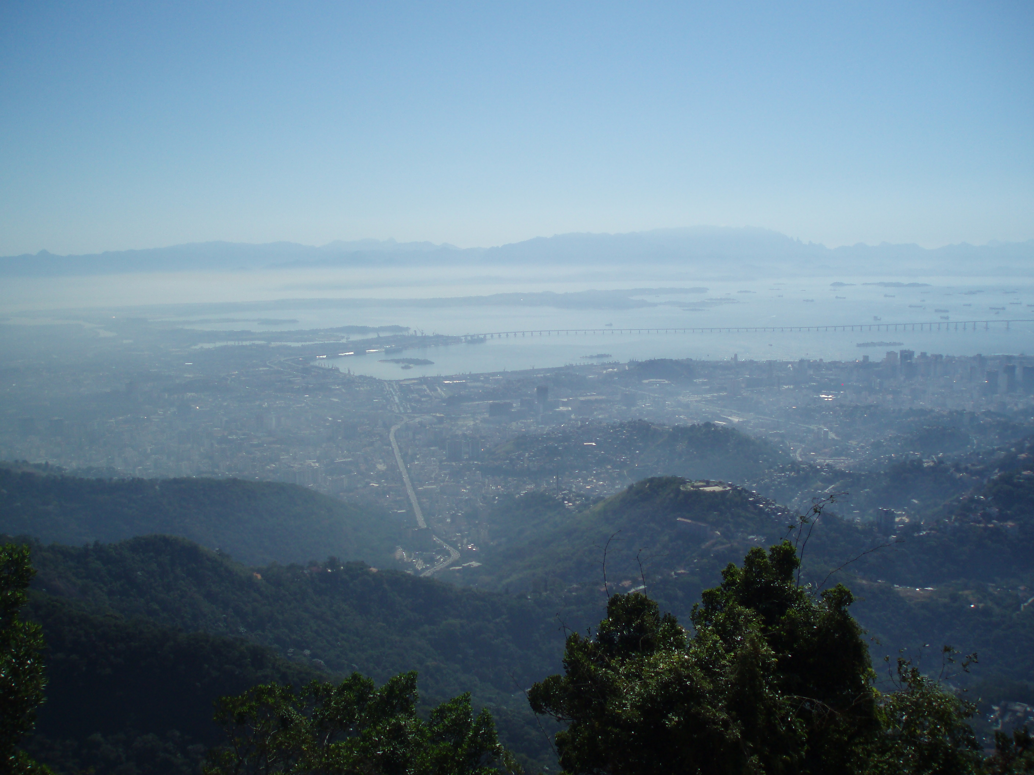
Introduction to Latin American Liberation Theology

Slide 2

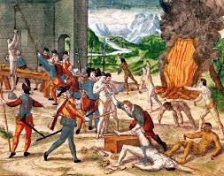
Latin American Liberation Theology
The Historical Context
12 October 1492 Christopher Columbus landed in what he called Hispaniola (Little Spain), today the Dominican Republic.
22 April 1500 Pedro Álvares Cabral, a Portuguese adventurer, landed in what is now Brazil, first called the Land of the True Cross, then of the Holy Cross.

Slide 3
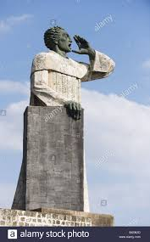
Latin American Liberation Theology
Fray Antonio de Montesinos (c. 1475 – 1545)
Spanish Dominican friar, living in Hispaniola.
On 21 December 1511, preached a famous sermon against the Spanish practice of encomienda, which gave landowners rights over the people on the land they owned which were more or less akin to slavery.

Slide 4
Latin American Liberation Theology
Montesinos said:
Tell me by what right of justice do you hold these Indians in such a cruel and horrible servitude? On what authority have you waged such detestable wars against these people who dwelt quietly and peacefully on their own lands? Wars in which you have destroyed such an infinite number of them by homicides and slaughters never heard of before. Why do you keep them so oppressed and exhausted, without giving them enough to eat or curing them of the sicknesses they incur from the excessive labour you give them, and they die, or rather you kill them, in order to extract and acquire gold every day.

Slide 5
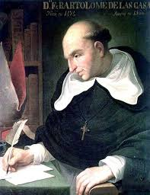
Latin American Liberation Theology
Fray Bartolomé de las Casas (c. 1484–1566)
A landowner in Hispaniola and a priest.
Heard Montesino’s sermon and initially rejected it.
In 1514, preparing a sermon he read Ecclesiasticus (Sirach) 34:21-25 and was persuaded that Montesinos had been right.

Slide 6
Latin American Liberation Theology
Ecclesiasticus (Sirach) 34:21-25:
If one sacrifices ill-gotten goods, the offering is blemished; the gifts of the lawless are not acceptable. The Most High is not pleased with the offerings of the ungodly, nor for a multitude of sacrifices does he forgive sins. Like one who kills a son before his father's eyes is the person who offers a sacrifice from the property of the poor. The bread of the needy is the life of the poor; whoever deprives them of it is a murderer.

Slide 7
Latin American Liberation Theology
De las Casas gave up his property and went to Spain to plead on behalf of the indigenous peoples.
He would later join the Dominicans and remained a tireless campaigner for the indigenous.
Originally he supported the African slave trade, though he later came to see that this too was wrong.

Slide 8
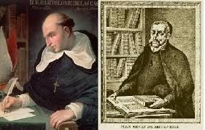
Latin American Liberation Theology
In 1550–51 de las Casas entered into debate in Valladolid, Spain with a Spanish theologian Juan Ginés de Sepúlveda (1494–1573) on whether the indigenous peoples had rights to govern themselves and be treated as fully human, with the rights that went along with that. De las Casas prevailed in principle, even if the practices remained largely untouched.

Slide 9
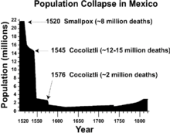
Latin American Liberation Theology
Effects of Conquista
Population Decline
- War
- Famine
- Illness (the major cause)
In part this led to the introduction of slavery – some 12 million Africans were transported to South America and the Caribbean.

Slide 10
Latin American Liberation Theology
Country | Independence
Haiti | I January 1804 (from France)
Colombia | 20 July 1810 (from Spain)
Mexico | 16 September 1810 (from Spain)
Chile | 18 September 1810 (from Spain)
Paraguay | 14 May 1811 (from Spain)
Venezuela | 5 July 1811 (from Spain)
Argentina | 9 July 1816 (from Spain)
Peru | 28 July 1821 (from Spain)
El Salvador | 15 September 1821 (from Spain)
Guatemala | 15 September 1821 (from Spain)
Honduras | 15 September 1821 (from Spain)
Brazil | 7 September 1822 (from Portugal)
Costa Rica | 15 September 1821 (from Spain)
Nicaragua | 15 September 1821 (from Spain)
Bolivia | 6 August 1825 (from Spain)
Uruguay | 25 August 1825 (from Brazil)
Dominican Republic | 27 February 1844 (from Haiti)
Cuba | 20 May 1902 (from Spain 10 December 1898; administered by the US from 1898 to 1902)
Panama | 3 November 1903 (from Colombia; became independent from Spain 28 November 1821)
Belize | 21 September 1981 (from UK)
Puerto Rico | none (territory of the US with commonwealth status)

Slide 11

Latin American Liberation Theology
Industrialisation and debt - Latin America since 1945
Following WWII, many of the economies in Latin America moved from an export base (normally of crops, such as coffee or sugar) to one called import-substitution industrialisation (ISI).
This entailed a massive programme of industrialisation so that the country could produce its own goods instead of importing them (hence the name).

Slide 12
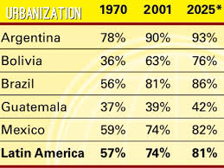
Latin American Liberation Theology
Industrialisation and debt - Latin America since 1945
Rapid progress of urbanisation.

Slide 13
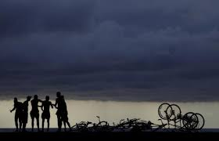
Latin American Liberation Theology
Industrialisation and debt - Latin America since 1945
Required huge capital investment through loans from outside. Petrodollars, mid- to late seventies. Hugely increased oil revenues led to investments by mainly Arab countries in western banks, who were keen to lend this money at advantageous rates to countries in the south. The debt crisis stems from that period, allied to subsequent global recessions and changes in terms of trade which have hit Latin American countries very hard.

Slide 14

Latin American Liberation Theology
Immediate background
Founding fathers born in the late 1920s or early 1930s.
The youngest of the famous first generation of theologians, Leonardo Boff, was born in 1938, ten years after Gustavo Gutiérrez.
So, they were beginning their theological studies in the fifties.

Slide 15
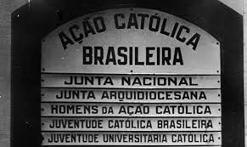
Latin American Liberation Theology
Catholic Action
Begun under Pius X, but main impetus from the pontificate of Pius XI, who saw it as an important tool for the Church’s engagement with the world.
Intended for Catholic laypeople (principally men), to promote the Church’s social teaching. The idea was to enthuse especially Catholic intellectuals with the need to spread the gospel in the modern world.
It certainly had an effect on Gutiérrez who, before entering the seminary, had begun medical studies in Lima and took part in a group of Catholic Action.

Slide 16
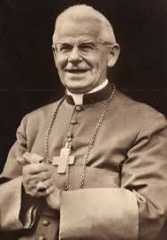
Latin American Liberation Theology
Young Christian Workers and the Pastoral Cycle
Founded by Father (later Cardinal) Joseph Cardijn in Belgium.
To offer a serious alternative to socialism for young Christians in their workplaces.
Pastoral Cycle: See Judge Act
The Young Christian Workers gave rise to various other similar groups, including Young Christian Students, a university based version. Gutiérrez and others were heavily involved with these groups in the early sixties.
Both groups called for active presence of the Church, specifically of the laity, in the world.

Slide 17

Latin American Liberation Theology
The French connection
Study in France in 1950s.
Influence of nouvelle théologie, developed by such theologians as Henri de Lubac, Yves Congar and Jean Daniélou.
Sought to go back to patristic sources, in order to allow theology to dialogue with the contemporary world.
Put on hold by Pius XII, but would dominate the Second Vatican Council and much subsequent theological thought.

Slide 18

Latin American Liberation Theology
The French connection
Worker-priest movement: priests who sought to practice their ministry working alongside other people in factories and trades.
Also in France certain adaptations of Marxist thought were in vogue - for example, Althusser and to a lesser degree Gramsci.
Intellectual climate was one of renovation, of experimentation.

Slide 19
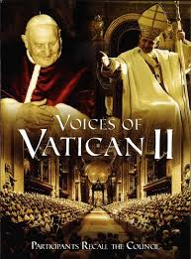
Latin American Liberation Theology
Vatican II
Hard to overestimate the importance of this council on the development of theology and theologians.
At the level of reactions and opening horizons, it is clear that for the generation who were ending their studies around this time, it was something which gave them the permission to go on asking the questions which had been around, but which the rigid pre-conciliar scholastic theology had not been able even to address, let alone answer.

Slide 20
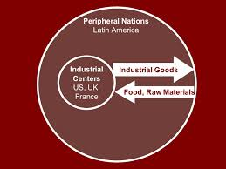
Latin American Liberation Theology
Dependency Theory
Explanation of structural reasons for the problems facing Latin American economies.
Previously theory of development.
Argued that Latin American economies would be permanently at a disadvantage because they were always dependent on (and in that sense inferior to and exploited by) other dominant economies, who determined what they could do.
This also led to a greater likelihood of authoritarian regimes, since the need to adopt strong measures to placate the dominant power was more likely to be met by governments who were not forced to take public opinion into account.

Slide 21
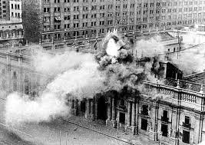
Latin American Liberation Theology
Latin American dictatorships and responses to them
Inspired by the Brazilian armed forces who took power in 1964, several other governments over the next ten years were deposed by military governments, up to the brutal overthrow of Salvador Allende, the Chilean president, by General Pinochet in 1973.
Formation of guerrilla movements, inspired by Fidel Castro and Che Guevara.
Groups mainly small and largely ineffective, being crushed fairly easily by the military regimes they sought to fight.

Slide 22

Latin American Liberation Theology
Resistance arose out of student movements, often previously Church-based student movements, such as the Young Christian University Students or, in Brazil, Popular Action, (Açao Popular), which, founded in the aftermath of the Cuban revolution in 1959, allied itself to the Brazilian Communist Party.
Not all shared the same political perspective, but against a background of extremely nationalist right-wing dictatorships, of varying degrees of brutality, the only two groups who sustained a credible opposition were the Church and the various communist groupings.

Slide 23
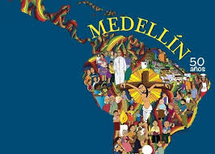
Latin American Liberation Theology
1968: the Second General Conference of CELAM, the Latin American Bishops’ Conference, took place in the Colombian town of Medellín.
Strong statement of Church’s decision to view life from the perspective of the poor oppressed majorities of the South.
Documents much influenced by input of those who would become noted liberation theologians (including Gustavo Gutiérrez)

Slide 24
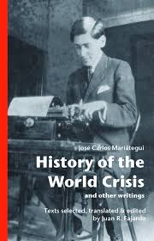
Latin American Liberation Theology
Indigenous Marxism
José Carlos Mariátegui (1895-1930) Of mixed Indian and Spanish stock, he was interested in the rediscovery of cultural wholeness, integrating the spiritual and the material in a way which owed much to the indigenous and Catholic culture in which the people of Peru are so deeply rooted.
He, and of course Castro’s revolution in Cuba, have had a great influence on liberation theology.
Liberation theology has also had recourse to the works of Marx himself.

Slide 25
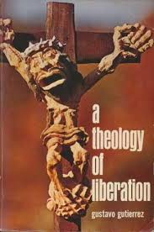
Latin American Liberation Theology
Development of Liberation Theology
July 1968: Gutiérrez gave talk to a group of priests and lay people in Peru, entitled “Towards a Theology of Liberation”.
The ideas sketched out in that paper were developed for his book “A Theology of Liberation”, published in Spanish in 1971 and in English in 1973.

