Slide 1
Introduction to Missiology
Class One
What is Mission?

Slide 2
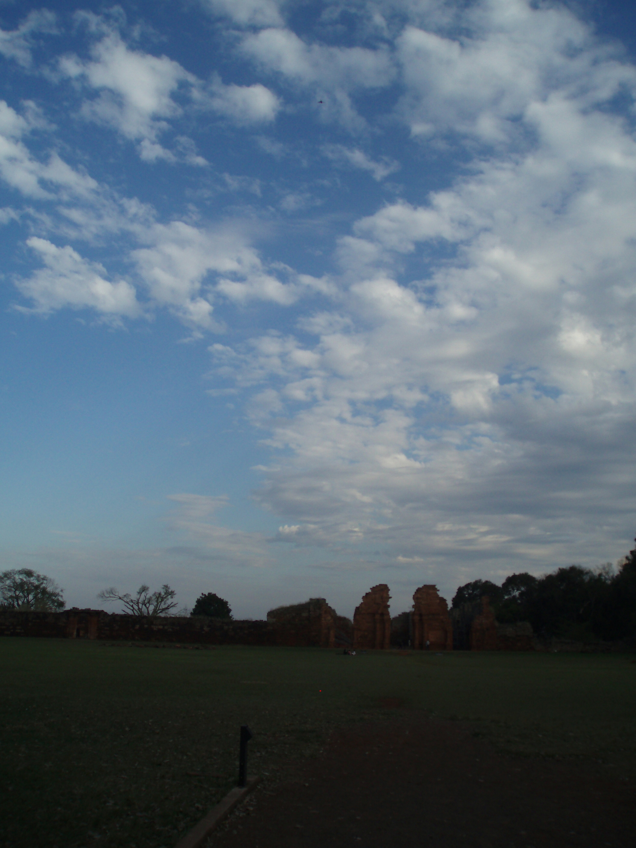
Introduction to Missiology
What are we talking about?

Slide 3
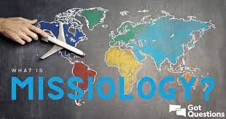
Introduction to Missiology
Three Further Questions
What is mission?
Who “does” mission?
And to [or better] with whom?

Slide 4

Alan Tippett, Introduction to Missiology, Pasadena, CA., William Carey Library, 1987, xiii
  Missiology is defined as the academic discipline or science which researches, records and applies data relating to the biblical origin, the history (including the use of documentary materials), the anthropological principles and techniques and the theological base of the Christian mission.

Slide 5
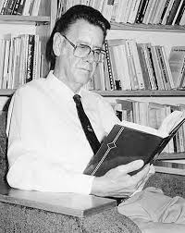
Introduction to Missiology
David Bosch (1929 – 1992)
Transforming Mission: Paradigm Shifts in Theology of Mission (1991)
The “pluriverse” of missiology
Four traditional ways of understanding mission
a) propagation of the faith
b) expansion of the reign of God
c) conversion of the “heathen”
d) founding of new churches

Slide 6

Challenges to Mission

Slide 7
Introduction to Missiology
problems of belief (Enlightenment)
dechristianisation of the West
problems associated with colonialism and different forms of oppression, leading to the question
can we use the word “mission”?

Slide 8
Introduction to Missiology
Bosch’s pluralist definition of mission
- Christian faith is intrinsically missionary
Ultimately mission remains undefinable – approximations of what mission is all about
Christian mission gives expression to the dynamic relationship between God and the world
Christian existence as missionary existence
No such thing as “foreign missions” in theological terms
David Bosch, Transforming Mission (Maryknoll, NY: Orbis, 1991), 9

Slide 9
Introduction to Missiology
Distinction between “mission” and “missions”, missio Dei and missiones ecclesiae
Mission includes spiritual and social engagement
Mission includes evangelism, but is not limited to it
Mission is God’s “yes” and “no” to the world, affirming what is of God and rejecting what is not of God
The church in mission is sign and sacrament
Bosch, Transforming Mission, 10–11.

Slide 10
Introduction to Missiology
Missio Dei
Mission as participation by the church of Christ in the mission of God (the sending of the Son and the Spirit by the Father)
So, mission in the first place is being sent by God
But also being sent by the church
Mission as fundamentally ecclesial activity

Slide 11
Introduction to Missiology
Five Marks of Mission (Anglican Communion)
To proclaim the Good News of the Kingdom
To teach, baptise and nurture new believers
To respond to human need by loving service
To transform unjust structures of society, to challenge violence of every kind and pursue peace and reconciliation
To strive to safeguard the integrity of creation, and sustain and renew the life of the earth

Slide 12
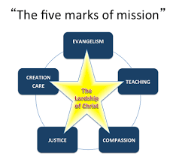
Introduction to Missiology

Slide 13
Introduction to Missiology
History
1984 Anglican Consultative Council (ACC-6): four “dimensions” of mission
1988 Lambeth Conference: these four dimensions as mission of the church.
1990 ACC-8: a fifth “affirmation”: To strive to safeguard the integrity of creation and sustain and renew the life of the earth.
1996 Adopted by the Church of England’s General Synod
1998 Lambeth Conference: The Five Marks of Mission in our Communion.

Slide 14
Introduction to Missiology
To proclaim the Good News of the Kingdom
- Is this the fundamental dimension?
- Mission and Evangelism
- Kerygmatic dimension of mission
- How to proclaim?
- What is proclaimed?
- For what end?

Slide 15
Introduction to Missiology
To teach, baptise and nurture new believers
“Go therefore and make disciples of all nations, baptizing them in the name of the Father and of the Son and of the Holy Spirit, and teaching them to obey everything that I have commanded you.” (Matthew 28.19-20).
Disciple, baptise, teach?
Teach, baptise, disciple?

Slide 16
Introduction to Missiology
To respond to human need by loving service
- Proclamation in what is done as well as what is said
- The social and charitable dimension of missionary activity
- Arguments between some evangelicals and others over priorities
- How, if at all, do church missions differ from secular NGOs?

Slide 17
Introduction to Missiology
To transform unjust structures of society, to challenge violence of every kind and pursue peace and reconciliation
- The social justice element of mission
- Mission as peacemaking
- Mission as reconciliation

Slide 18
Introduction to Missiology
To strive to safeguard the integrity of creation, and sustain and renew the life of the earth
- The ecological task
- Mission includes the recognition and proclamation of God as creator, as Christ as the icon of the invisible God, in whom all things are created (Col. 1:15 ff.)
- What do these last two marks say about the nature of mission?

