Slide 1
INTRODUCTION TO MISSIOLOGY
CLASS TWO
MISSIOLOGY AS A DISCIPLINE

Slide 2
INTRODUCTION TO MISSIOLOGY
An Introduction to the Study of Mission
Paul Kollmann, "Defining Mission Studies in the Third Millennium." In: The Oxford Handbook of Mission Studies, eds. Kirsteen Kim (ed.), Alison Fitchett-Climenhaga (ed.) (Oxford University Press, 2022), 37-55.
A basic definition:
The various words for the study of mission have to with
“studies—a wide-ranging notion labeling multifarious informal and formal scholarly undertakings—that focus on mission, a term that has come to designate human e􀁼orts to spread Christianity.” p. 37

Slide 3
INTRODUCTION TO MISSIOLOGY
What does it mean to study something?
- Why study a subject?
- How to study a subject?
- Who studies it?
- Where is it studied (educational, social, geographical contexts)?
- What is the aim of the study?

Slide 4
INTRODUCTION TO MISSIOLOGY
Paul Kollmann points to the variety of ways that understandings of mission have changed over the past century or so, and thus necessarily how its study has changed.
We will turn shortly to look in more depth at this history. To sum up:
The word “mission” had a prehistory within theology prior to being deployed to describe Christian efforts to spread the faith—part of speculative reflection on the Trinity, since the Son and Holy Spirit had “missions” from God the Father. In addition, since its sixteenth-century application to evangelizing efforts, the term’s content has never ceased to be subject to ongoing theological reflection. Thus, even when limited by the implied further adjective “Christian,” the field of Christian mission studies resists an obvious and self-evident definition. (p. 39).

Slide 5
INTRODUCTION TO MISSIOLOGY
Why the changes?
Post-colonialism
Interest outside of theology:
Christian mission has grown as an object of study in numerous fields, including literary studies, various social-scientific disciplines, history (including the history of science), and area studies linked to the colonized and colonizing world. Missionaries and their work have been studied for insight into the emergence of ethnic and linguistic identities, the nature of colonialist rhetoric, the classification of biological species of plants and animals, and for roles in galvanizing colonialist, as well as proto-independent and democratizing, political attitudes. (p. 41).

Slide 6
INTRODUCTION TO MISSIOLOGY
Theological changes
Mission as multi-directional
Missio Dei
The Importance of the Kingdom of God
Mission as proclamation and deed
The integration of Christian mission more deeply with God’s active ongoing presence in the world as missio Dei, and the tighter connection of mission to Christ’s ministry, have meant a corresponding placement of mission at the centre of church life for many Christian bodies. This transformation has affected mission theology itself, as well as Christian theology and church experience more generally. p. 42

Slide 7
INTRODUCTION TO MISSIOLOGY
The Pre-History
Middle Ages, learning Arabic
Dutch East India Company
Mostly about language learning, very little theological reflection on the nature or purpose of mission
The word itself begins to be used by Jesuits in the sixteenth century – earlier intra-Trinitarian term.

Slide 8
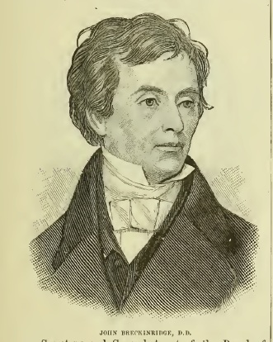
INTRODUCTION TO MISSIOLOGY
Early Missiologists
Already some people teaching subjects related to mission in eighteenth century. First to have a chair in something including the word “mission” was John Breckinridge (1797-1841), Princeton Theological Seminary, Professor of Pastoral Theology and Missionary Instruction, 1836 - 1839.

Slide 9
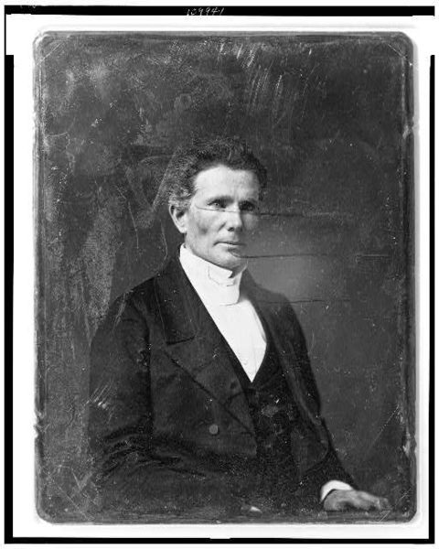
INTRODUCTION TO MISSIOLOGY
Alexander Duff (1806–1878) .Missionary in India. Professor of Evangelistic Theology in Edinburgh, 1867–70. Chair discontinued when he left.

Slide 10
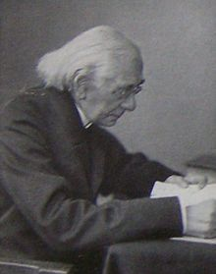
INTRODUCTION TO MISSIOLOGY
Gustav Warneck (1834–1910), first chair in mission sciences in Germany, at University of Halle (from 1898). The father of Protestant missiology. Evangelische Missionslehre (5 vols, 1892-1903)

Slide 11
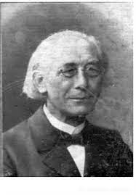
INTRODUCTION TO MISSIOLOGY
Born 1834 in Naumburg
Father was needle maker and family was poor
Managed to get to Gymnasium and then to university in Halle
Studied theology
1862 Married Henrietta Gerlach

Slide 12
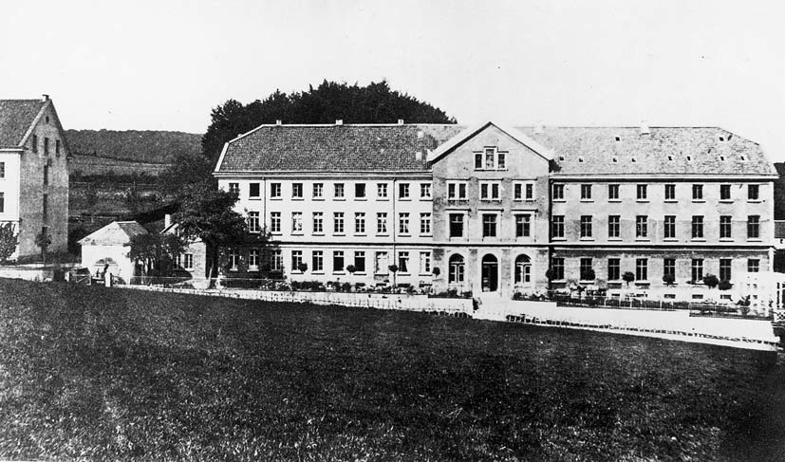
INTRODUCTION TO MISSIOLOGY
Wanted to be missionary overseas, but health did not allow it
1863-1870 Pastor near Leipzig
1871 doctorate from Jena
1871-1874 Rheinische Missionsgesellschaft in Barmen
1874 Allgemeine Missions-Zeitschrift

Slide 13
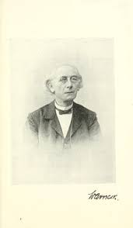
INTRODUCTION TO MISSIOLOGY
1874-1896 Pastor in Rothenschirmbach, near Eisleben
Advisor to missionaries and mission leaders
1896-1908 Professor of Missionswissenschaft (mission studies) at University of Halle
Died on 26 December 1910

Slide 14
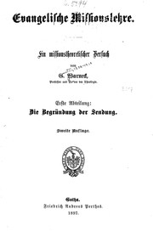
INTRODUCTION TO MISSIOLOGY
Warneck, Evangelische Missionslehre (Gotha: F. A. Oerthes, 1897-1903)
  Biblical foundations of mission
  Pietist influences
  German Romanticism
  Attempt to help missionaries reflect more fundamentally on their work

Slide 15
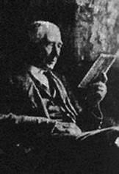
INTRODUCTION TO MISSIOLOGY
Among his contributions:
Pastor
Preacher
Teacher
Writer
Prophet

Slide 16
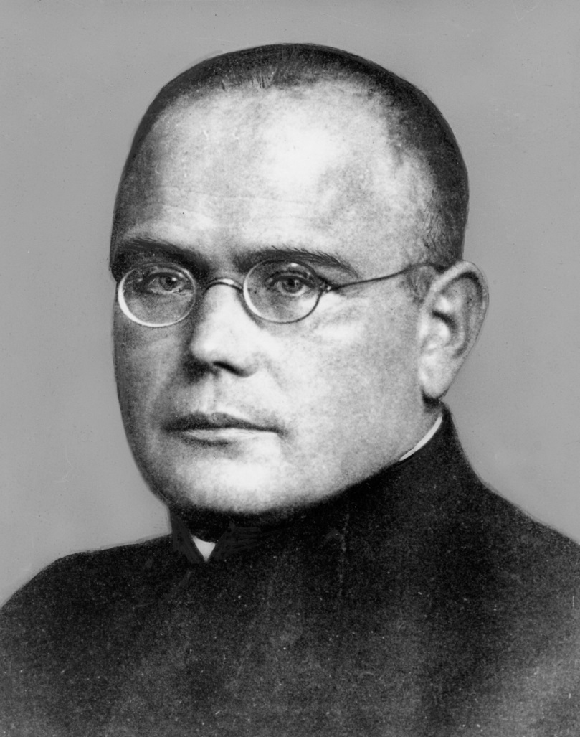
INTRODUCTION TO MISSIOLOGY
Josef Schmidlin
Born 1876 in Alsace, not long integrated into German Empire after the Franco-Prussian War
Educated in Strasbourg
Ordained priest in 1899
Doctorates from Freiburg in 1901 and 1903

Slide 17
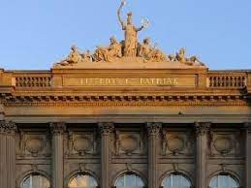
INTRODUCTION TO MISSIOLOGY
1906 becomes a lecturer in church history at new Catholic Theological Faculty in Strasbourg.
Not for the first or last time, difficult personal relationships, so only stayed one year

Slide 18
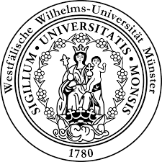
INTRODUCTION TO MISSIOLOGY
1907 moves to Münster
Originally teaching church history (specialised in history of the popes and medieval history)
Starts to teach mission sciences in 1910
1914 Chair of Mission Studies established

Slide 19
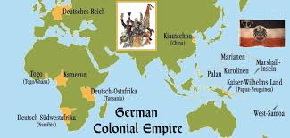
INTRODUCTION TO MISSIOLOGY
Much more than Warneck, Schmidlin was a German nationalist, who thought mission and empire went together.

Slide 20
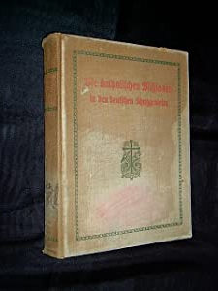
INTRODUCTION TO MISSIOLOGY
Apart from many articles, Schmidlin’s three major books are
Einfuhrung in die Missionswissenschaft (2nd ed., 1925)
Katholische Missionslehre im Grundriss (2nd ed. 1923)
Katholische Missionsgeschichte (1925)

Slide 21
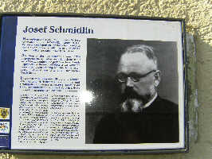
INTRODUCTION TO MISSIOLOGY
Sacked from the university in 1934 for refusing to use the “German greeting.”
Strongly opposed the Nazis.
1943 sent Schirmeck concentration camp where he was beaten to death, dying on 10 January 1944

Slide 22
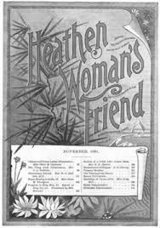
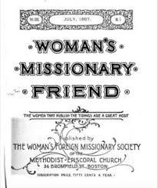
INTRODUCTION TO MISSIOLOGY
Published by the Woman's Foreign Missionary Society of the Methodist Episcopal Church from 1869. In the 1890s a campaign against the title by women missionaries in Japan, leading to the change of title.
One example among many of how women engaged in reflection on mission (which is essentially missiology, changed the ways in which people interacted with the other.

Slide 23
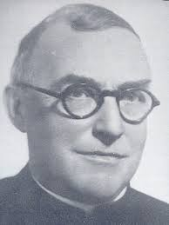
INTRODUCTION TO MISSIOLOGY
Pierre Charles SJ
Born in Brussels in 1883
His younger brother Paul was later Belgian Minister for the Colonies
In 1899 entered Jesuits
Studied in Holland (with German Jesuits) and Hastings, England, with French Jesuits
Ordained 1910

Slide 24
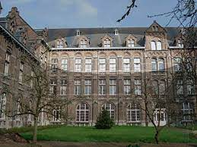
INTRODUCTION TO MISSIOLOGY
Professor of Theology at the Jesuit theologate in Leuven
In 1925 he took over the running of the Semaine de Missiologie in Leuven, running it until his death in 1954

Slide 25
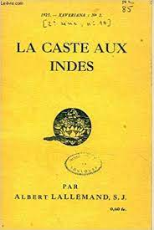
INTRODUCTION TO MISSIOLOGY
Started in 1923, initially led by a young Jesuit theology student, Albert Lallemand SJ (1890-1966), later a missionary in India.
First for missionaries from Belgian religious orders.

Slide 26
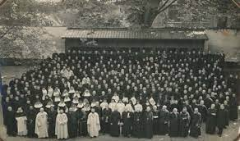
INTRODUCTION TO MISSIOLOGY
The use of the word “missiology”, which spread into English and other languages, is usually dated to these weeks.
Charles emphasised the importance of church planting, whilst Schmidlin emphasised more the conversion of individuals

Slide 27
INTRODUCTION TO MISSIOLOGY
“For Pierre Charles, planting means a vital insertion into the human matrix, into a sociocultural whole, in such a way that the whole of the gospel and of the church enters the whole life of a people. And the process is reciprocal. Father Charles underscored two aspects: mission does it, and mission should do it.”
Joseph Masson SJ, “The Legacy of Pierre Charles SJ”, Occasional Research in Mission Bulletin October 1978, 118–20.
Pierre Charles called for the building up of local churches, with local clergy
A tireless writer on many themes
Had desired to go to Africa but was not allowed

Slide 28
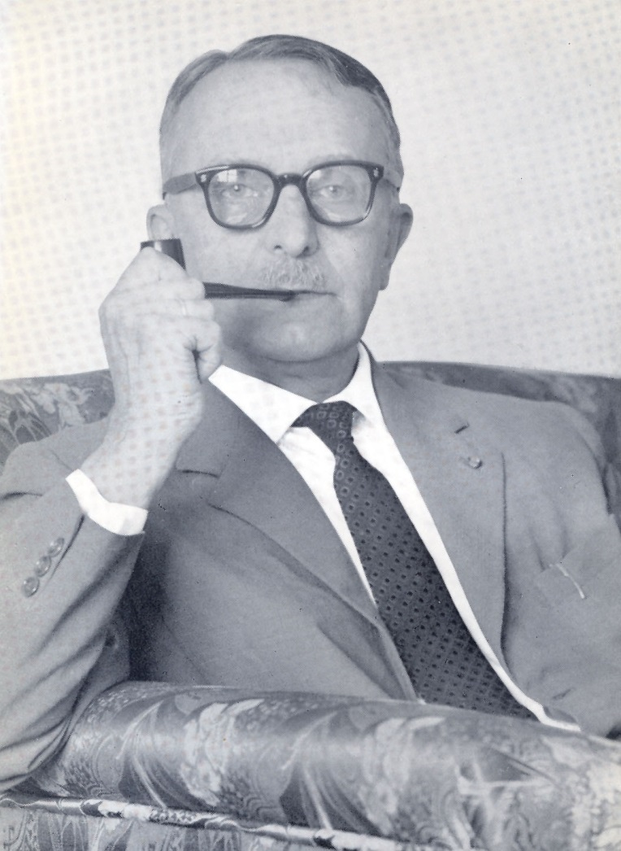
INTRODUCTION TO MISSIOLOGY
Dutch Missiologists Dr. Johan H. Bavinck (1895-1964)
Time in Indonesia, relations to non-Christian religions, religious mysticism

Slide 29
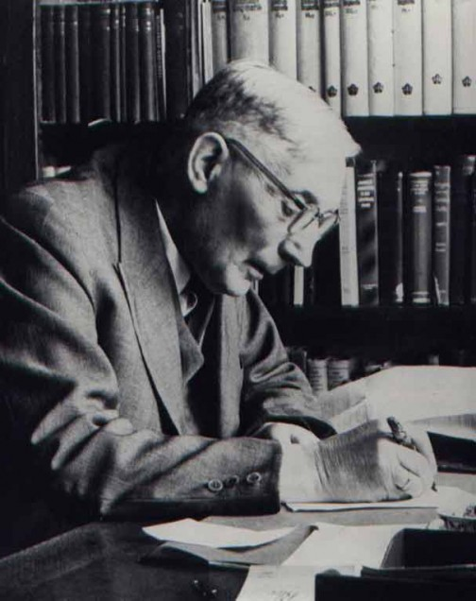
INTRODUCTION TO MISSIOLOGY
  Hendrik Kraemer (1888-1965)
The Christian Message in a Non-Christian World (1938)

Slide 30
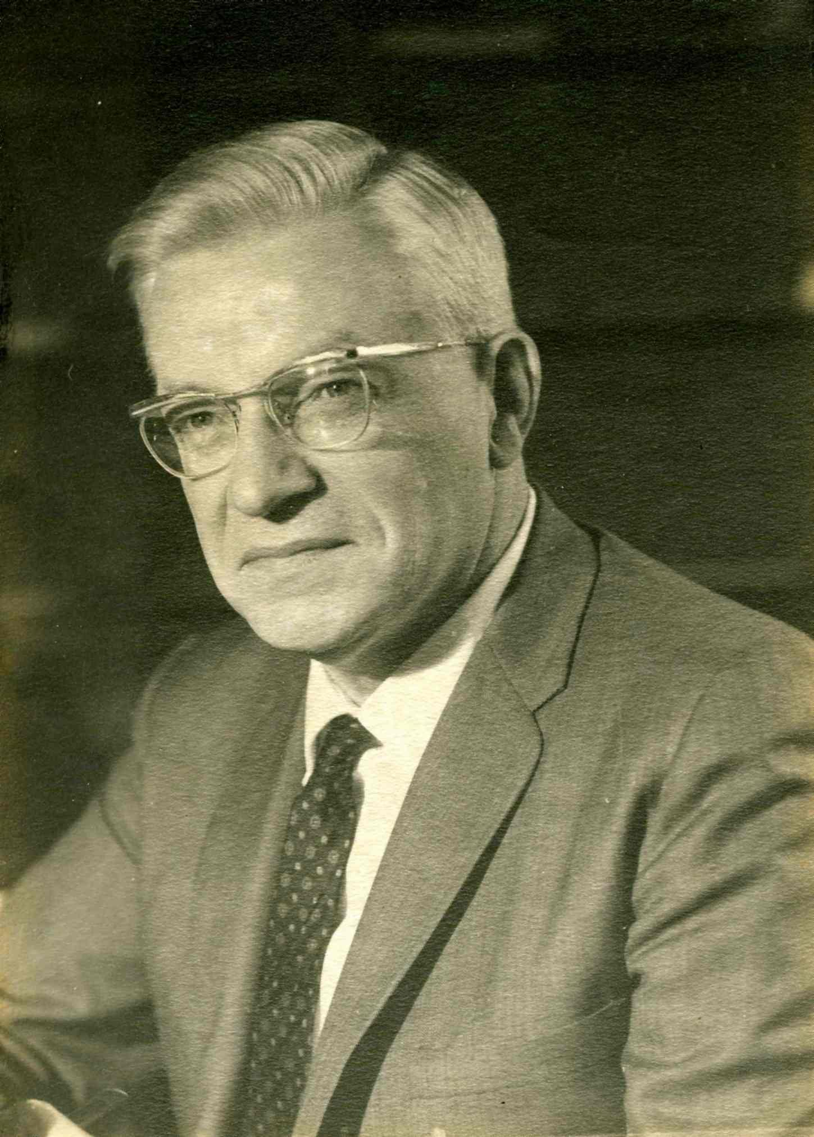
INTRODUCTION TO MISSIOLOGY
  Johannes Christiaan Hoekendijk (1912-1975)
Born in Indonesia, ecumenical, worked at WCC, taught in Netherlands and in the USA

Slide 31
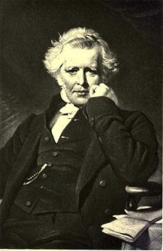
INTRODUCTION TO MISSIOLOGY
British and American Missiologists
Henry Venn (1796-1873) General Secretary of Church Missionary Society, the role of the local church

Slide 32
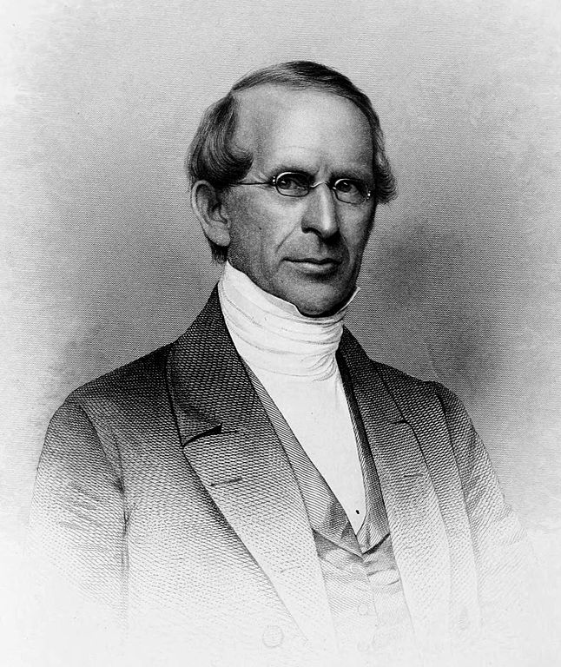
INTRODUCTION TO MISSIOLOGY
  Rufus Anderson (1796-1880), the “Three Self” churches
Self-governing
Self-propagating
Self-financing

Slide 33
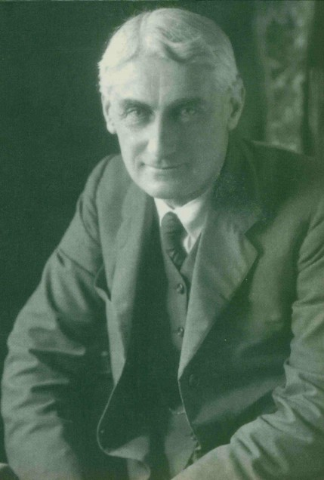
INTRODUCTION TO MISSIOLOGY
  Roland Allen (1868-1947) – missionary in China and Africa, the mission of Paul, the modern mission movement

Slide 34
INTRODUCTION TO MISSIOLOGY
What is the role and place of mission?
  Missiology as part of practical theology
  Missiology as part of church history
  Missiology as part of systematic theology
  Missiology as part of Biblical theology
  Missiology as underlying all theology, an element of every theological discipline

