Slide 1
Introduction to Missiology
Missional Hermeneutics

Slide 2
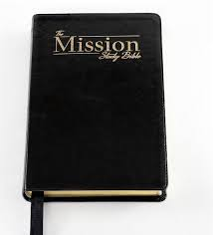
Introduction to Missiology
What passages from the bible would you associate with mission?

Slide 3
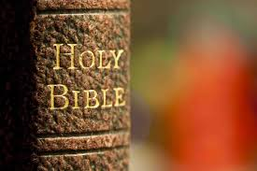
Introduction to Missiology
Missional Hermeneutics:
Reading the Bible as a book / books about mission

Slide 4
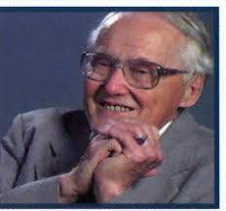
Introduction to Missiology
The Gospel and Our Culture Network (GOCN)
Inspired by the approach of Lesslie Newbigin (1909-1998), Scottish missionary in India, who on his return to Europe, reflected on Europe as a mission field.
GOCN began in UK, but much more active and important in North America.

Slide 5
Introduction to Missiology
Discussion on missional hermeneutics began in GOCN around the turn of the millennium
Some initial definitions
Michael Barram:
An approach to biblical texts that privileges the missiological “location” of the Christian community in the world as a hermeneutical key
Michael Gorman:
“missional hermeneutics is a form of theological interpretation.”

Slide 6

Introduction to Missiology
Michael Goheen (ed.), Reading The Bible Missionally (Grand Rapids, MI: Eerdmans, 2016).
Chapter 1 “A History and Introduction to a Missional Reading of the Bible”

Slide 7
Introduction to Missiology
Goheen:
Why have biblical scholars been slow to accept the idea that mission is a key to reading the Bible?
“the first fundamental problem is confusion about what the word “mission” means… as long as ‘mission’ means intentional efforts at spreading the Christian faith by word or deed, certainly it cannot be a central rubric for interpreting Scripture—especially not the Old Testament.”

Slide 8
Introduction to Missiology
Goheen:
Missiologists’ naïve use of Scripture
Ignoring “historical conditioning” of the biblical text, so biblical scholars unwilling to make connections between an ancient text and the present …
“Missiologists rightly react against this distancing but … frequently read their own missional concerns back into the biblical text.
“vulnerable to simplistic applications of the biblical text to the contemporary missionary setting.”

Slide 9
Introduction to Missiology
Goheen:
“biblical scholars stress the tremendous literary, theological, and semantic diversity of the scriptural record.”
“Frustrated with this fragmentation and specialization, and lamenting its debilitating impact on the church, missiologists tend to overlook this rich diversity and may reduce their biblical foundation for mission to a single word, idea, or text as the unifying hermeneutical lens through which to see Scripture.”

Slide 10
Introduction to Missiology
Goheen:
Signs of hope – helping missiologists read the bible and biblical scholars engage with mission
1. The Changing Situation of the Church in Western Culture and in the World
Now that the Western world is no longer overwhelm- ingly Christian, and has more contact with other parts of the world (Christian and non-Christian), new ways to approach the bible and new challenges to be faced

Slide 11
Introduction to Missiology
Goheen:
Signs of hope:
2 Growing Convergence on a New Understanding of Mission
Previous assumptions:
(1) mission: task for parachurch organizations; church has only a pastoral role;
(2) the world is divided into the Christian West (home base) and the non-Christian non-West (mission field);
(3) mission takes place on the non-Western mission field;
(4) no need for mission in the West, since it is already Christian:

Slide 12
Introduction to Missiology
Goheen:
Signs of hope:
2 Growing Convergence on a New Understanding of Mission
Missio Dei: Our mission begins with the mission of the triune God. But this Trinitarian mission must be understood in the narrative context of the biblical story.
The Scriptures tell the story of God’s work to restore the entire creation, and a people from all nations, from the debilitating impact of human rebellion. God chose a people to play a role in this mission and mission is an identity that comes from the role that God’s covenant people are called to play in the biblical story.
Mission defines the very being of God’s people. To say that their missional identity comes from the role they are called to play in the biblical story already points to the centrality of mission in reading Scripture.

Slide 13
Introduction to Missiology
Goheen:
Signs of hope:
3 Changes in the Discipline of Biblical Studies
Three important changes
Growing interest in theological interpretation of Scripture
Recognition that all readings are located readings
“canonical” or “longitudinal” readings of Scripture

Slide 14
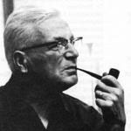
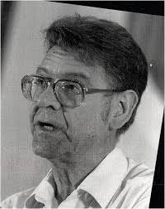

Introduction to Missiology
Goheen:
Signs of hope:
4 The Growing Contribution of Biblical Scholars to the Conversation
Important scholars –
Johannes Blauw
David Bosch
Christopher Wright

Slide 15
Introduction to Missiology
What does a missional hermeneutic look like?
Missional hermeneutic is
“a way of reading the Bible for which mission is the hermeneutical key. . . . [It is not] simply a study of the theme of mission in the biblical writings, but a way of reading the whole of Scripture with mission as its central interest and goal. . . . [It] would be a way of reading Scripture which sought to understand what the church’s mission really is in the world as Scripture depicts it and thereby to inspire and to inform the church’s missionary praxis.”
Richard Bauckham, “Mission as Hermeneutic for Scriptural Interpretation,” Currents in World Christianity Position Paper 106 (1999), 1

Slide 16
Introduction to Missiology
Three elements:
1 Mission as Central to the Biblical Story
We will come back to this in the next couple of classes, but essentially the argument is that the story of the Bible is the story of God’s engagement with his people.
This particular people is called to be a blessing to the whole world (so particular and simultaneously universal)
Mission is centripetal and centrifugal (drawing people in and sending them out)
Mission is an unfinished story

Slide 17
Introduction to Missiology
2 The Meaning of Mission
God gives his people a task, of being a blessing, of participating in God’s work, brought to its completion in the life, death and resurrection of Jesus Christ
This mission is universal in scope, both in terms of those to whom we are sent and in terms of what it includes (all nations, all creation)
Mission will be the daily experience of life, but there is a missional dimension and a missional intention (all is mission, but some things are intentionally missional)

Slide 18
Introduction to Missiology
3 Reading Scripture to Equip the Church for Missional Praxis
Scripture forms Christians for mission
To read the bible asking how it sought to form people for mission
Scripture as the product of mission or the needs of mission

Slide 19
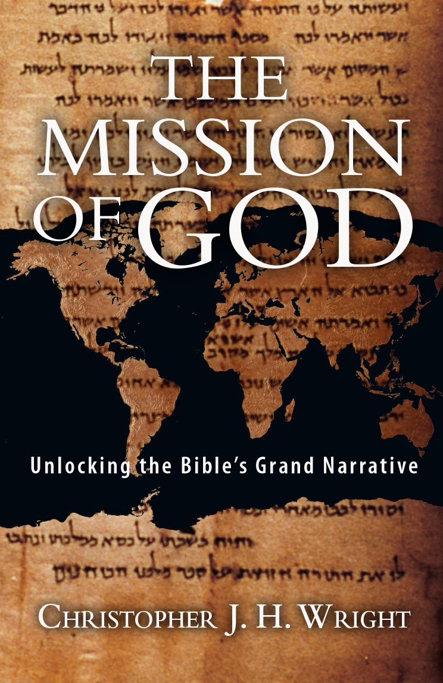
Introduction to Missiology
Christopher Wright, The Mission of God (Downers Grove, IL: Intervarsity Press, 2006)

Slide 20
Introduction to Missiology
It is “not just that the Bible contains a number of texts which happen to provide a rationale for missionary endeavour but that the whole Bible is itself a “missional” phenomenon.
The writings that now comprise our Bible are themselves the product of and witness to the ultimate mission of God.
The Bible renders to us the story of God’s mission through God’s people in their engagement with God’s world for the sake of the whole of God’s creation.”
Christopher Wright, The Mission of God (Downers Grove, IL: Intervarsity Press, 2006), 22

Slide 21
Introduction to Missiology
Wright understands mission in terms of “purpose”, goals to be achieved through various activities.
Mission as the accomplishment of God’s plan for his creation.
Wright sets out to produce a missional hermeneutic for the Bible (the “key” for reading the Bible’s ‘grand narrative’)
This grand narrative asks four questions
- Where are we?
- Who are we?
- What’s gone wrong?
- What is the solution?

Slide 22
Introduction to Missiology
The Bible is a product of mission, written for mission and out of mission (the mission of the people of God, and the mission of the early church)
The Bible is authoritative because of its missional impulse – the command to engage in mission is what gives it authority
The Bible insists on mission as coming from and being of God, connected to creation, fall, redemption and future hope

Slide 23
Introduction to Missiology
Tim Carriker, “The Bible as Text for Mission”, in Pauline Hoggarth, Fergus Macdonald, Bill Mitchell, Knud Jørgensen (eds.). Bible in Mission (Regnum Edinburgh Centenary Series Vol. 18) (Oxford: Regnum, 2013), 29–39.
Relationship of Bible and mission
“Is the Bible the subject of the conversation with ‘mission’, or is the Bible the object?”

Slide 24
INTRODUCTION TO MISSIOLOGY
Four ways of relating Bible and mission
 | Bible as Subject | Bible as Object
Mission of God | The Bible as the story of God’s mission – what it’s about. | The Bible as the product of God’s mission – how did it come about?
Churches’ Mission | The Bible as the history of missions – what happened? | The Bible as a missionary tool – how was the Bible used in mission?

Slide 25
Introduction to Missiology
Mission of the church only relevant within context of God’s own mission
Hermeneutical Relation between Mission and the Bible
Key for reading
God exists, implicitly one God above all
This God has a plan
The plan involves all God created
The world is not fickle or inconsistent for there exists a God who is in control

Slide 26
Introduction to Missiology
Paul Ricoeur – meaning “within the text”, meaning “behind the text”, meaning “in front of the text”
Carlos Mesters on reading the Bible in Latin America
pre-text
text
con-text

Slide 27
Introduction to Missiology
Mission behind the text
Darrell Guder (American, member of Gospel and Our Culture Network)… “emphasizes the missionary purpose of the authors and editors that produced the biblical text and the missionary concerns of the communities that they represent”.
“This perspective enquires about the historical origin of the biblical texts and the original missionary purpose that these texts served in the communities of original readers”
Tim Carriker, “The Bible as Text for Mission”, 33-34

Slide 28
Introduction to Missiology
Mission within the text
Chris Wright as prime proponent of this approach: quotation from Wright
“The Bible renders to us the story of God’s mission through God’s people in their engagement with God’s world for the sake of the whole of God’s creation”
Christopher Wright, The Mission of God, 11, in Tim Carriker, “The Bible as Text for Mission”, 34

Slide 29
Introduction to Missiology
Mission in front of the text
This approach asks how the Bible is read missionally today
“This perspective is characterized by a commitment to articulate faithfully the mission of God and the role that the community has in the fulfilment of that mission.”
Tim Carriker, “The Bible as Text for Mission”, 35
The contextual theological task

Slide 30
Introduction to Missiology
Implications of the three approaches
“The advantage of … using … Ricoeur’s three hermeneutical planes analogy…
legitimates the three perspectives by adopting different hermeneutical starting points as well as helping them to relate to each other…
to harmonise the various contributions into one missional hermeneutic of the Bible is neither necessary nor desirable.
Each of the three makes its own important and legitimate contribution”.
Tim Carriker, “The Bible as Text for Mission”, 36

Slide 31
Introduction to Missiology
“the attempt to make more explicit the missionary motives and intentions of the authors and the communities that contributed to the production of the various biblical documents – the missional meaning ‘behind’ the text – clarifies the missional plot ‘within’ the text that runs through Scripture.
And that in turn is the essential basis for the more responsible reflection on the missional location of the readers of these texts throughout history to this day and in each social and ethnic context”.
Tim Carriker, “The Bible as Text for Mission”, 36

Slide 32
Introduction to Missiology
The Bible as a text for missionary preparation (the study of mission)
Studying also what the Bible has to say about mission, and how a wide number of themes are involved in such a reading (election, covenant, justice, judgement, messianic hope, salvation, creation and new creation)
Bible study in missionary conferences

Slide 33
Introduction to Missiology
The Bible as a missionary tool
The importance of biblical translations, starting with the Targum and the Septuagint, and continuing in the Christian Era with the translation of the Bible, itself written in a “translation” into Greek
“the intimate correlation between Bible translation and the evangelization of the peoples who speak those languages … this follows from the very missionary nature of the Scriptures themselves”
Tim Carriker, “The Bible as Text for Mission”, 39

