Slide 1
INTRODUCTION TO MISSIOLOGY
MISSIONARY STORIES

Slide 2
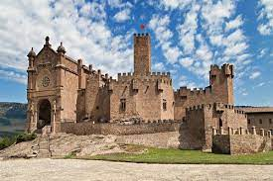
INTRODUCTION TO MISSIOLOGY
Iñigo López de Loyola born 1491 in Loyola in the Province of Guipúzcoa, at that time a part of the Kingdom of Navarre.
Normal life of a younger son of a noble family.
Served in various capacities in the court of the Viceroy of Navarre.
“Until the age of twenty-six he was a man given up to vanities of the world, and his chief delight used to be in the exercise of arms, with a great and vain desire to gain honour”.

Slide 3
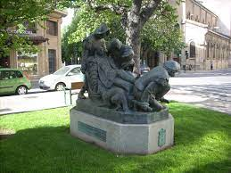
INTRODUCTION TO MISSIOLOGY
1521 – leg broken during siege of Pamplona
Came close to death, and then had the leg re-broken
While recuperating, he read the only two books in the castle, a Life of Christ, and a book on lives of the saints.
He dreamt of following them or serving a “certain lady”.

Slide 4
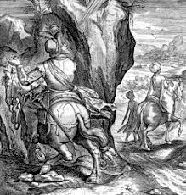
INTRODUCTION TO MISSIOLOGY
After his recovery, he set off on pilgrimage.
His first missionary encounter:
As he was riding on his mule, he came across a “Moor”, a Spanish Muslim, travelling in the same direction, and they fell into conversation.
The topic turned to Our Lady, and the Moor, though happy to accept the virginal conception of Jesus, was not prepared to accept that Mary had remained a virgin after the birth of Jesus.

Slide 5
INTRODUCTION TO MISSIOLOGY
Ignatius was angry with his conversation partner and unsure whether to follow him and kill him or leave it be.
The man was heading for a small village, just off the main road.
So he decided to let the mule decide. If the mule kept on the main road, he would leave the man, if it went to the village, he would kill him. Fortunately for all concerned
“Our Lord willed that, though the town was little more than thirty or forty paces away, and the road leading to it very broad and very good, the mule took the main road, and left the one for the town behind”

Slide 6
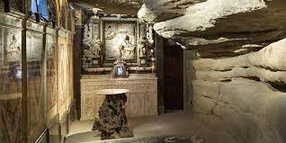
INTRODUCTION TO MISSIOLOGY
He later spent a year in a small town called Manresa.
He spent the time in prayer and ascetic practice.
Here the initial experiences that would later, in part, be systematised into the Spiritual Exercises took place, and he came to have a clearer understanding of his own calling and of how God was constantly at work in his life.
It was a growing experience, especially of the love of God that drew him on and called him to respond, that would inform his understanding of mission as service in love.

Slide 7
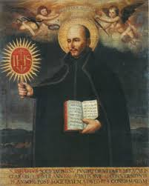
INTRODUCTION TO MISSIOLOGY
Ignatius was probably the first to take the medieval use of the language of mission as an intra-trinitarian term and apply it to the task of proclamation in deed and word of the gospel.
For him, this task was the crucial one of the Christian, and even more specifically of those who were his companions in Christ.
At the heart of this engagement was the need to serve in love.

Slide 8
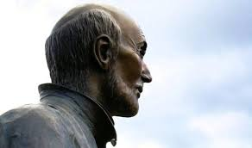
INTRODUCTION TO MISSIOLOGY
The Call of the King
First Point. I put before me a human king chosen by the hand of God our Lord, to whom all Christian leaders and their followers give their homage and obedience.
Second Point. I watch how this king speaks to all his own, saying: "My will is to conquer all the land of the infidels. Therefore, all those who want to come with me will have to be content with the same food as I, the same drink, the same clothing, etc. Such persons will also have to work with me by day and keep watch by night, etc., so that in this way they will afterwards share with me in the victory, as they have shared with me in the labours."
Third Point. I consider what reply good subjects should make to such an open and kindly king, and on the other hand, if anyone refused to accept the request of such a king, how greatly such a person would deserve to be blamed by everyone and to be judged an unworthy knight.

Slide 9
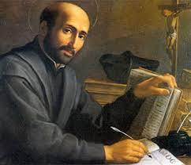
INTRODUCTION TO MISSIOLOGY
The second part of this Exercise consists in applying the above parable of the temporal King to Christ our Lord, following the three Points mentioned.
First Point. If such a call made by an earthly king to his subjects is worthy of our consideration, how much more is it worthy of consideration to see Christ our Lord, the eternal King, and before Him the entire human race, as to all and to each one in particular His call goes out, "My will is to conquer the whole world and every enemy and so enter into the glory of my Father! Therefore, all those who want to come with me will have to labour with me, so that by following me in my suffering, they may also follow me into glory."
Second Point. We should consider that all who have judgment and reason will offer themselves completely for the task.

Slide 10
INTRODUCTION TO MISSIOLOGY
Third Point. Those who will want to respond in a spirit of love, and to distinguish themselves by the thoroughness of their commitment to their eternal King and universal Lord, will not only offer themselves bodily for the task, but rather by going against their sensuality and their carnal and worldly love will offer greater and more important sacrifices, saying:
"Eternal Lord of all things, I make my offering, with your favour and help, before your infinite Goodness, and before your glorious Mother and all the saints of the heavenly court! My resolute wish and desire, and my considered determination – on the sole condition that this be for your greater service and praise – is to imitate you in enduring every outrage and all contempt, and utter poverty, both actual and spiritual, if your most Holy Majesty wants to choose me and receive me into that life and state."

Slide 11
INTRODUCTION TO MISSIOLOGY
Response to the mission of Christ is a desire to participate in that mission.
Spiritual Exercises, contemplation on the Incarnation and Annunciation.
Contemplating the Trinity, gazing down on “the whole round world”, seeing people in all conditions, of joy and sorrow, sickness and health, war and peace, and desiring to redeem the world.
Universality of this picture – the repetition of words like “all” or “the whole”, in which the gaze and the sight of the Trinity settles on the whole of human endeavour, on all humanity in its wondrous diversity.
Out of this setting the Son is sent, for the universal mission of redemption.
The offer of redemption, the possibility of being redeemed, as something that is made to all of humankind – the Trinity say: “Let us bring about the redemption of the human race, etc”. And as the mission of Christ is to all humankind, so the mission of his followers must also be.

Slide 12
INTRODUCTION TO MISSIOLOGY
The Two Standards
the mission of Lucifer, “the mortal enemy of our human nature”, involves sending his adherents through the whole world (a universal mission), tempting people “first to crave after riches (the enemy’s usual tactic), so that they might come more readily to the empty honours of the world and in the end to unbounded pride”.
Against this the equally universal mission of Christ: “the Lord of all the world selects so many persons as apostles, disciples, etc., and sends them out over the whole world spreading His sacred doctrine among all people of every state and condition”.
Ignatius’ grasp of the centrality of the response to the gift of love, as a joyous self-giving in mission.

Slide 13
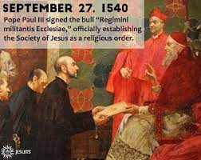
INTRODUCTION TO MISSIOLOGY
Whoever wishes to serve as a soldier of God beneath the banner of the cross in our Society, which we desire to be designated by the name of Jesus, and to serve the Lord alone and his vicar on earth, should keep it in mind that once he has made a solemn vow of perpetual chastity he is a member of a community founded chiefly for this purpose: to strive especially for the progress of souls in Christian life and doctrine, and for the propagation of the faith by the ministry of the word, by spiritual exercises and works of charity, and specifically by the education of children and unlettered persons in Christianity

Slide 14
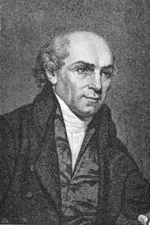
INTRODUCTION TO MISSIOLOGY
William Carey (1761–1834) often claimed as one of the founding fathers of the modern missionary movement
Born in the middle of England, suffered ill-health as a child, and was apprenticed to a cobbler (shoemaker)
There he met a Baptist and was baptised on 7th October 1783
He worked as a pastor, schoolteacher and cobbler, though he was not great at any of them.

Slide 15

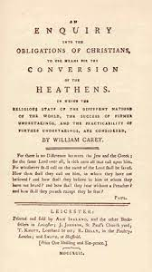
INTRODUCTION TO MISSIOLOGY
In 1791 published a short pamphlet, entitled An Enquiry into the Obligations of Christians, to Use Means for the Conversion of the Heathens, in which the Religious State of the Different Nations of the World, the Success of Former Undertakings, and the Practicability of Further Undertakings Are Considered
One of the most influential texts on mission in this period

Slide 16
INTRODUCTION TO MISSIOLOGY
A Christian minister is a person who in a peculiar sense is not his own; he is the servant of God, and therefore ought to be wholly devoted to him. By entering on that sacred office he solemnly undertakes to be always engaged, as much as possible, in the Lord’s work, and not to chuse [sic] his own pleasure, or employment, or pursue the ministry as a something that is to subserve his own ends, or interests, or as a kind of bye-work. He engages to go where God pleases, and to do, or endure what he sees fit to command, or call him to, in the exercise of his function. He virtually bids farewell to friends, pleasures, and comforts, and stands in readiness to endure the greatest sufferings in the work of his Lord, and Master. It is inconsistent for ministers to please themselves with thoughts of a numerous auditory, cordial friends, a civilized country, legal protection, affluence, splendour, or even a competency. The flights, and hatred of men, and even pretended friends, gloomy prisons, and tortures, the society of barbarians of uncouth speech, miserable accommodations in wretched wildernesses, hunger, and thirst, nakedness, weariness, and painfulness, hard work, and but little worldly encouragement, should rather be the objects of their expectation.

Slide 17
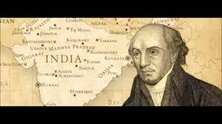
INTRODUCTION TO MISSIOLOGY
Arrived in India 11th November 1793. He was not permitted to act as a missionary in the territory ruled by the East India Company.

Slide 18
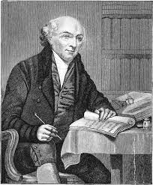
INTRODUCTION TO MISSIOLOGY
For some six years, Carey managed an indigo plant, and learned languages.
He began translating the New Testament into Bengali.
In 1800 he moved to Serampore, part of India ruled over by the Danes.
That year he gained his first Indian convert, Krishna Pal.

Slide 19
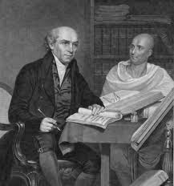
INTRODUCTION TO MISSIOLOGY
Carey had a variety of reactions to the Indians he met.
His first teacher was Ram Ram Basu, who did not convert, but helped Carey in translation and in explaining the Scriptures to others.
Carey was suspicious of Hindu beliefs, and campaigned against the burning of widows.

Slide 20
INTRODUCTION TO MISSIOLOGY
Carey was a man of his times. He suffered great personal stress (his first wife went mad, his second died still quite young, and he lost one of his sons in India to dysentery).
But he worked tirelessly in learning languages and translating the Bible, and at his best respected the people among whom he worked.
He was an important figure in Indian history, too, mainly for his scientific work.
At some levels, in terms of converts, he may not have been a successful missionary, but he was much loved and remained faithful to his call.

Slide 21
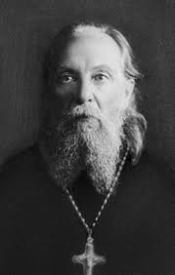
INTRODUCTION TO MISSIOLOGY
Archimandrite Spiridon Kislyakov
Born Georgii Stepanovich Kislyakov in 1875
From a small village called Kazinka, roughly 75 kilometres (“four days on foot”) from Zadonsk, in the province of Voronezh, in southern Russia.

Slide 22
INTRODUCTION TO MISSIOLOGY
As a young man, inspired by various figures, including some brothers in his village who gathered people together to read the Bible
Also a holy man called Simeon Samsonovitch who encouraged him in his life of prayer
Still in his teens, he embarked with Simeon on pilgrimages – first to Zadonsk, to the tomb of St Tikhon, then to Kiev.
Finally, still only in his early teens, he set off en route to Athos, via Odessa and Constantinople.
Already open to the other – he is happy to find that Hagia Sophia is still a place of God, even if now for Muslims.

Slide 23
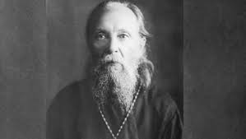
INTRODUCTION TO MISSIOLOGY
Spiridon spent some time on Athos, with a few years in Constantinople in between, where he was encouraged in his vocation by a conversation with some mullahs.
Despite his love of the monastic life, he was troubled by the nationalisms on Athos and the monks’ desire for money and eventually left.
Moved to St Petersburg (Petrograd).

Slide 24
INTRODUCTION TO MISSIOLOGY
After many travels and adventures, and several episodes of falling in love and almost marrying, he ended up as a missionary in Siberia.
Encounters with Buddhists and Shamans, whom he treats with respect and whom he always considers very positively and whose critique of Christians, including missionaries, he recognises as just
He also worked as a prison chaplain
In 1903 he was tonsured as a monk and ordained as a priest.

Slide 25
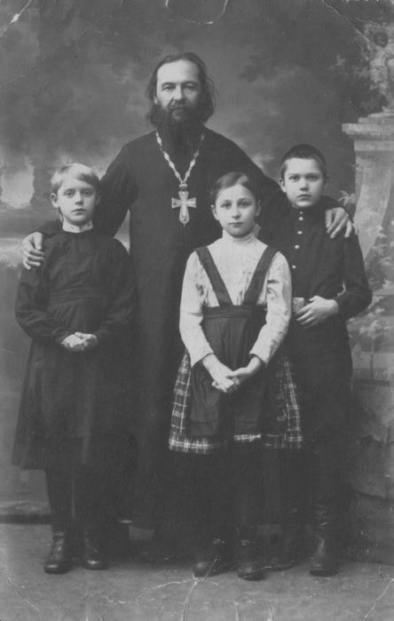
INTRODUCTION TO MISSIOLOGY
1904 – outbreak of Russo-Japanese War, ending in defeat for Russia: 1905: Revolution
“I was just beginning to open my eyes to the realities of war, of the State, of nationality, of swearing oaths, but these were only the first glimmers of the awakening of my conscience. ... Instead of the absolute Christian law – the Sermon on the Mount – I was presented with Sergius of Radonezh blessing his monks to go and fight the Tatars, and an incalculable number of saints in Russia, Greece and other Christian countries, who also blessed those who went to war.”

Slide 26
INTRODUCTION TO MISSIOLOGY
Spiridon never nationalist, but first inclinations were to support military action.
Followed by resentment, both towards Christ, for “his indifference to the fratricidal struggles of humankind,”, but even more towards the church.
“From the day it had fraternised with the State it had distanced itself from its Founder”, to such an extent that today “it can do without Christ, reckoning that it can easily replace him with popes, patriarchs, metropolitans, archbishops, bishops and all the ecclesial hierarchy”.

Slide 27
INTRODUCTION TO MISSIOLOGY
Shortly after the outbreak of World War I, concluded a sermon, saying that “as long as Christians wage war, they have no right to call themselves Christian”.
Reported to his Archbishop, Nazarii Kirillov (1850–1928), who summoned Spiridon and told him that “the current war is a holy war … All teaching that condemns the war is inspired by Tolstoy”.
Spiridon was convinced that “war is integral evil”, but on the other hand he saw how the church blessed the war with the Cross and the gospel, how preachers drew on biblical texts to show it was holy.
In the end, a fellow monk advised him to go the front, where he would see for himself whether the war was of God or the devil.

Slide 28
INTRODUCTION TO MISSIOLOGY
Worked on south-western front as chaplain in two field hospitals and a private hospital, and he even came to think that he was accomplishing God’s work.
At the same time he felt lost, even more when appointed as chaplain to troops going to war.
He recalls how, after the liturgy and his sermon, the soldiers would “leave the church filled with fury like wild beasts, breathing out hatred against the Germans”.
One day, after the liturgy and receiving Holy Communion, a young soldier came to him and asked
"Father, how can I go back to my post after taking communion? I have received Christ Himself within me, I have united myself with the God of Christians, so how can I now go and kill other men? The image of Christ on my face will command the killing and if it is my turn to be killed, then Christ Himself will be killed at the same time as I am. What am I to do now?"

Slide 29
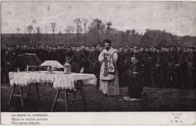
INTRODUCTION TO MISSIOLOGY
Spiridon found himself unable to answer. When later another soldier asked if it was a sin to bear arms, he replied that it was a terrible sin.
“‘A sin?’, said the soldier, ‘but then why send us into battle? Why do you pastors bless war in the name of the Christian God and send us off to die in the scrapyard? How can we believe you? Where is the truth in you?’”

Slide 30
INTRODUCTION TO MISSIOLOGY
“as a pastor of the Church, servant at the altar of Christ, I should not only not become mixed up in war and not set Christians against each other through my sermons, but even more, I should passionately preach peace and mutual love between brothers and sisters and I should always be ready to suffer, even to death if necessary, in order to follow the precepts of Christ. These precepts are holy and eternal peace and divine love without limits.”
Spiridon: there has never been a Church council or synod that has spoken about how to pass on to the people the moral teaching of the church as found in the Sermon on the Mount and that neither is the Sermon mentioned in the Symbol of Faith

Slide 31
INTRODUCTION TO MISSIOLOGY
“Christ demands to be served without the slightest reservation. In turn, civil government demands that Christians obey to the last drop of their blood. … In place of the kingdoms of this world, which possess innumerable armies and inhuman power, Christians are called to build up here below, by a conduct of holiness and peace, the new kingdom of the God of the universe. In the same way, political power requires believers, on pain of death, to reinforce the anti-Christian life of the government by subjugating more fragile peoples. ... I realised that in our time the Orthodox Church is a cog in the State machine.”

Slide 32
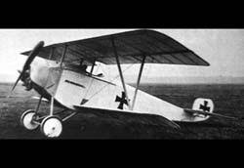
INTRODUCTION TO MISSIOLOGY
One day, visiting troops on the front, he saw a German aeroplane, painted with a black cross, and saw bombs being launched over the longitudinal of the cross. He reacted to this by recalling:

Slide 33
INTRODUCTION TO MISSIOLOGY
“‘By this sign you will triumph’: when I remembered these words, I almost fainted with horror, I was devastated. Since then, I have considered the State to be the worst enemy of Christ, the life of the Church to be a betrayal of Christ, a part of the clergy to be a caste which, from the Sanhedrin and Judas to the present day, has subjected Christ to a new Golgotha.”

Slide 34
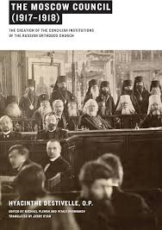
INTRODUCTION TO MISSIOLOGY
Convinced of the evil of war and of the evil of church support for the war, addressed himself to the forthcoming Moscow Council, which would open in 1917. (“A Priest’s Confession to the Church”).
The church, he said, “places above [the Sermon on the Mount] the veneration of idols, of relics, of the decrees of canon law and the apostolic succession”.

Slide 35
INTRODUCTION TO MISSIOLOGY
Church needs to beg forgiveness of Russia for its failings: “Forgive us, holy and suffering Russia. From now on we want to become your authentic pastors, not the lackeys of power, transforming ourselves into faithful servants of the one heavenly and earthly King, Jesus Christ”.
But:
“Alas! Not only does the Council not envisage repenting its former sins, but it has decided in the name of the whole Church to commit an unprecedented transgression; in the sea of blood of corpses and on the bones of its Orthodox children, it has resolved to preach ‘a quiet and peaceful life’ for the Church”.

Slide 36
INTRODUCTION TO MISSIOLOGY
“As bearers of the image and likeness of God, human beings are not answerable to Caesar but to God alone.”
Spiridon saw the problems as dating from the time of Constantine and the decision of the Council of Arles in 314 to excommunicate anyone who refused to take up arms in peace time
The Latin reads “ut qui in pace arma projiciunt excommunicentur”. Seems to mean that whoever refuses to take arms in peace time is excommunicated. But what exactly in pace means, and to what extent this was enforced is another question.

Slide 37
INTRODUCTION TO MISSIOLOGY
Spiridon’s assessment:
in his context, “all the heads of the universal Church are not only war-mongers but they also pay ritual homage to war”
and
“[f]rom the day the World War broke out, Christianity took on the appearance of a very mournful procession which, with rifles in hand, sabres drawn, cannons, asphyxiating gas, incendiary bombs, aeroplanes, trains, on horseback or on foot, marched to bury Christ in all haste.”

Slide 38
INTRODUCTION TO MISSIOLOGY
Spiridon confesses: “I gave communion to more than two hundred thousand soldiers who then left to kill Christians: it was as if I was sending Christ himself to kill people and to be killed”.
He asks the Council: “What is most precious for us? Christ or the power of the world?”
Perhaps not altogether surprisingly Spiridon received no reply to his letter, though it is probably to the credit of the newly-elected Patriarch Tikhon that he did not forward it on to Spiridon’s bishop, thus saving him a lot of difficulties.

Slide 39
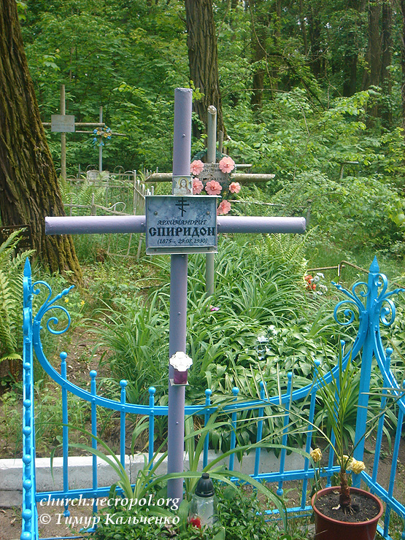
INTRODUCTION TO MISSIOLOGY
Spiridon lived the rest of his life in Kyiv.
Started a community, the Brotherhood of the Most Sweet Jesus, engaged in liturgical reform and work with the poorest.
Died on 11 September 1930.

Slide 40
INTRODUCTION TO MISSIOLOGY
Archimandrite Spiridon’s contribution to mission
- Mission as engagement with the other
- Mission as a journey, searching for God
- Mission and the struggle for peace
- Mission and obedience to the Church, which also includes calling the Church to task for its failures
- Mission and Liturgy
- Mission and aid for those in need

