Slide 1
Introduction to Missiology
MISSIONARY STORIES

Slide 2
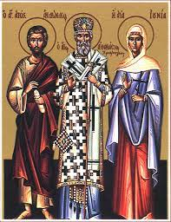
Introduction to Missiology
Greet Andronicus and Junia, my relatives who were in prison with me; they are prominent among the apostles, and they were in Christ before I was.
ἀσπάσασθε Ἀνδρόνικον καὶ Ἰουνίαν [aspásasthe Andrónikon kai Iounían] τοὺς συγγενεῖς μου καὶ συναιχμαλώτους μου, οἵτινές εἰσιν ἐπίσημοι ἐν τοῖς ἀποστόλοις, οἳ καὶ πρὸ ἐμοῦ γέγονεν ἐν Χριστῷ.
Romans 16:7
Sts Andronicus, Athanasius of Christianopoulis, and Junia

Slide 3
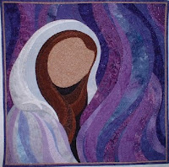
Introduction to Missiology
Acts 16:13-15 On the Sabbath day we went outside the gate by the river, where we supposed there was a place of prayer; and we sat down and spoke to the women who had gathered there. A certain woman named Lydia, a worshiper of God, was listening to us; she was from the city of Thyatira and a dealer in purple. The Lord opened her heart to listen eagerly to what was said by Paul. When she and her household were baptized, she urged us, saying, "If you have judged me to be faithful to the Lord, come and stay at my home." And she prevailed upon us.

Slide 4
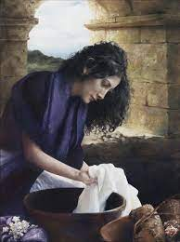
Introduction to Missiology
Meeting at proseuch. (proseuche) place of prayer, but could also refer to a synagogue).
Discussions about the status of Lydia, which generally depend on what point the scholar is arguing for (rich or poor, elite or despised).
Probably relatively well-off, possibly a Gentile close to Judaism, can be read in parallel with the story of Peter and Cornelius.

Slide 5
Introduction to Missiology
Lydia as host and leader in community
Cf. Romans 16:1-6 I commend to you our sister Phoebe, a deacon of the church at Cenchreae, so that you may welcome her in the Lord as is fitting for the saints, and help her in whatever she may require from you, for she has been a benefactor of many and of myself as well.
Greet Prisca and Aquila, who work with me in Christ Jesus, and who risked their necks for my life, to whom not only I give thanks, but also all the churches of the Gentiles. Greet also the church in their house.
Greet my beloved Epaenetus, who was the first convert in Asia for Christ.
Greet Mary, who has worked very hard among you.

Slide 6
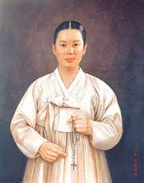
Introduction to Missiology
Kollumba (Colombe, Columba) Kang Wansuk (1760-1801).
Korean Catholic Church began in 1777 when a group of scholars began to study Christian texts.
One of them got to Beijing in 1784, where he was baptised and returned to spread the word further among his network of friends.

Slide 7
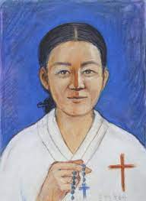
Introduction to Missiology
Kollumba was born in 1760 in a district about 100 kilometres south of Seoul.
Her family were from the upper-class, possibly through an illegitimate line.
In around 1775, she was married to a widower, Hong Chiyong, who seems to have been a fairly unattractive personality.
In 1782 her daughter Sunhui was born.

Slide 8
Introduction to Missiology
She first became aware of Christianity some time between 1785 and 1791.
In 1791, she was arrested in a round up of Catholics.
She had converted her mother-in-law, her stepson, and her parents, but her husband moved between acceptance and rejection.
He divorced her, probably after her arrest, and she went to live in Seoul.

Slide 9
Introduction to Missiology
In Seoul, she reached out to the other Catholics, and helped finance the bringing of Fr Zhou Wenmo from China in 1795, the first priest in Korea.
She even hid the priest in the female quarters of her own house in Seoul, a very dangerous action, as Christianity was already being persecuted.
Several people connected with Fr Zhou’s arrival were executed in 1795.

Slide 10
Introduction to Missiology
Kollumba served in many different roles for Fr Zhou.
He founded an organisation called Myŏngdohoe [Society for the Illumination of the Way].
This organised secret meetings to instruct Koreans in Catholic doctrine, with members from different classes and men and women.
Kollumba was appointed head of the female meetings, as a women’s catechist, working with people ranging from slaves to members of the royal family.

Slide 11
Introduction to Missiology
Effectively, she not only acted as a missionary to other Korean women, but also prepared them to go out as missionaries themselves.
The church grew fairly rapidly, numbering around 10 000 when a great persecution (called the Sinyu persecution after the name of the Korean year in which it occurred) broke out in 1801.

Slide 12
Introduction to Missiology
She managed to acquire a large library of Catholic books and texts
Kollumba also served as the voice of Fr Zhou, who apparently spoke only a little Korean. Even at masses she seems to have been the one to read or speak (presumably also preach) in Korean.
Also promoted virginity, a chance for Korean women to be independent of lives planned by others for them.

Slide 13
Introduction to Missiology
Kollumba Kang Wansuk was arrested in April 1801.
She was heavily tortured in an attempt to get her to apostasies, but she held firm.
She was executed by beheading on July 3 1801.
Her legacy was one that inspired the Korean Catholic Church, which continued to grow, despite undergoing periodic severe persecutions.

Slide 14
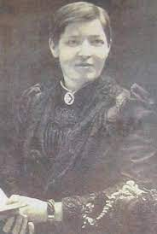
Introduction to Missiology
Mary Mitchell Slessor (1848-1915)
Born at Gilcomston, Aberdeen, on 2 December 1848.
Her father was a shoemaker, from a reasonably wealthy farming family.
Some of the family were quite educated, with two relatives having studied at Cambridge, and one becoming a clergyman in Aberdeen.
She attended the local United Presbyterian Church, and her mother and later Mary herself were avid readers of missionary stories in the The Missionary Record, with tales of David Livingstone and of Calabar, in south-eastern Nigeria.

Slide 15
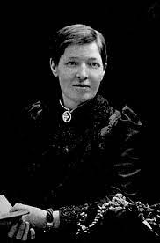
Introduction to Missiology
Her father was a heavy drinker, and lost his job, so the family moved to Dundee, when Mary was 11.
Her father struggled to find work, and spent his wages on drink, and was prone to violence against the family.
From the time she moved to Dundee she was working in a cotton factory, first half-time and from the age of fourteen full-time.

Slide 16
Introduction to Missiology
She claims to have been a “wild lassie”, who was converted by an old lady who frightened her with the thought of hell.
However, there is little evidence of this “wildness”, and she seems to have been heavily involved in the church, teaching Sunday School, involved in Home Missions, engaging in missions in the slums of Dundee.

Slide 17
Introduction to Missiology
Following the death of David Livingstone in 1874, a wave of missionary fervour spread through Scotland.
In 1875 Slessor decided to apply to be a missionary in Calabar. Her application was accepted and she set off in August 1876, arriving in mid-September.
The Calabar mission was a few years’ older than her, and a place of danger because of illness, so that most missionaries either died en route or when they arrived.

Slide 18
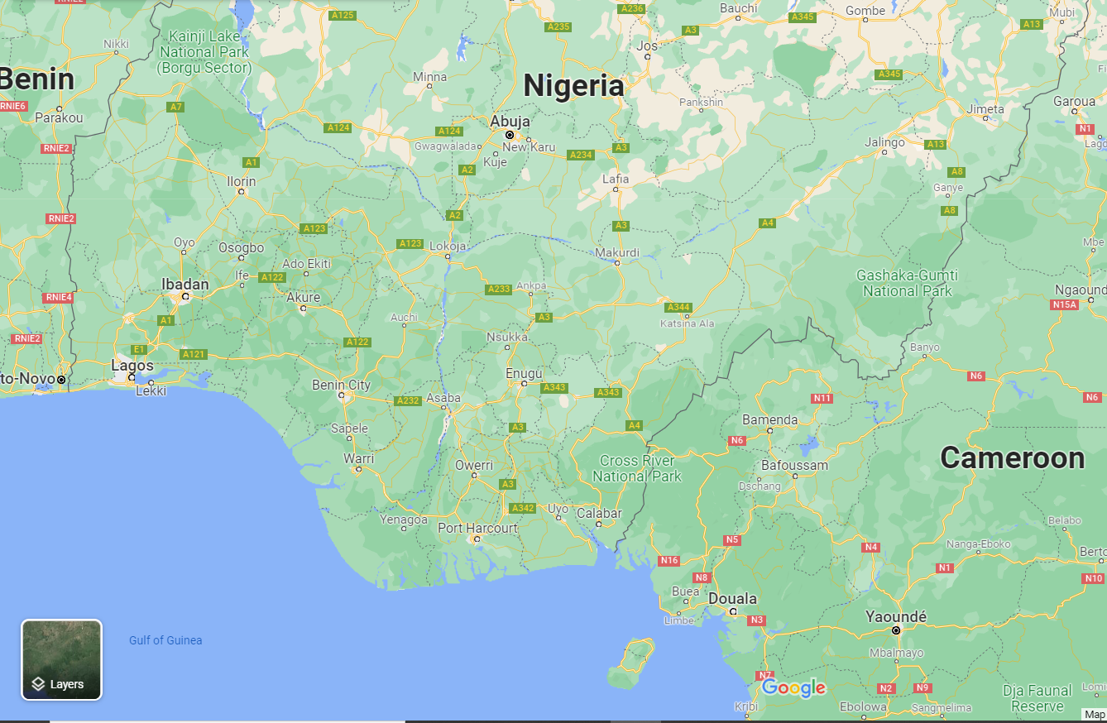
Introduction to Missiology
Her initial impressions were positive, and she was taken with the surroundings.
One biographer notes that she probably never completely overcame the prejudices of the time, and a certain sense of superiority.

Slide 19
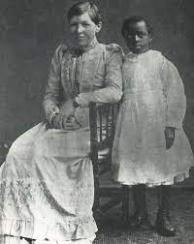
Introduction to Missiology
She learned the local language, Efik, and was well-known for going around with the local children, climbing the trees with them.
But her main desire was to work with the women of the region, who had largely been ignored and had not been converted.
She grew ill and in 1879 returned to Scotland to recuperate and visit her mother and sisters in Dundee.

Slide 20
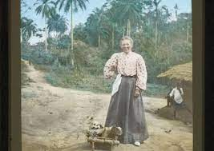
Introduction to Missiology
Slessor returned to Calabar in 1880, and was put in charge of her own mission, in a place called Old Town.
She lived simply on local food, such as plantains, bananas, cassava, coco, maize, and sugar cane.
The only “luxury” she needed was her tea.
So she began to live as an African, and a relatively poor one, which helped her in her work.

Slide 21
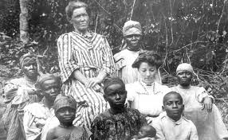
Introduction to Missiology
One of the local customs she worked to eradicate was the killing of twins.
It was thought that in the case of twins one was a kind of demon, and because it was not possible to tell which, both had to be killed, and often the mother expelled from the community.

Slide 22
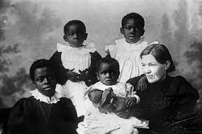
Introduction to Missiology
In 1883, she took ill again and returned for leave to Scotland, taking with her a young girl called Janie (or Jean), a twin she had rescued.
Janie was baptised in Scotland, and they returned in 1885 to Calabar.
Not long after, her mother and her one remaining sister both died.

Slide 23
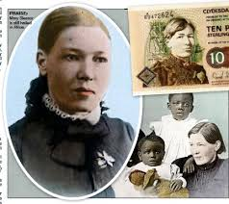
Introduction to Missiology
She was now in a new mission station in a place called Creek Town.
She adopted more children, who lived with her.
She suffered from malaria, but she also sought supplies of quinine to give to those who were ill.

Slide 24
Introduction to Missiology
In 1888 she moved further west to the territory of the Okoyong people.
She used her limited medical supplies and knowledge to help heal various people, including the local chief, Edem.
Slessor also dealt with the problems of polygamy. She later came to see that it may be the only way for women to survive, and suggested “friend marriages”.

Slide 25
Introduction to Missiology
In 1890 she became engaged to another much younger missionary, Charles Morrison.
She said she would only marry him if he could join her in her mission station.
The mission board refused and the engagement was broken off.
Morrison died in the United States not long after.

Slide 26
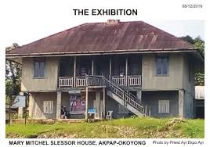
Introduction to Missiology
In 1891 she was asked to become the British Vice-Consul in the region, and serve as the local magistrate.
She was the first woman in the British Empire to serve in such a role.
In 1896 she moved to the town of Akpap, to be closer to the heart of local Okoyong life.

Slide 27
Introduction to Missiology
Over the course of some twenty or more years, Mary Slessor adopted at least nine children, apart from others who spent time living with her.
Most were either twins or had been abandoned at birth for one reason or other.
She was remembered as a loving and devoted mother.

Slide 28
Introduction to Missiology
To Europeans, Mary was known as the “white Queen”.
The local people called her “the white Ma who lives alone,” and eventually eka kpukpru owo—everybody’s mother.
In 1905 she moved further north west to Itu.
There she learned to ride a bicycle to help her in her work for the government.

Slide 29
Introduction to Missiology
From 1906, her final home was in Use Ikot Oku, not far from Itu.
In 1907 she made her final visit to Scotland.
Despite her unusual methods, and the apparent lack of converts, there is no doubt that she retained a strong Christian faith and desire to share the gospel.
She died in the early morning of 13 January 1915.

