Slide 1
Introduction to Missiology
The Churches and Mission

Slide 2
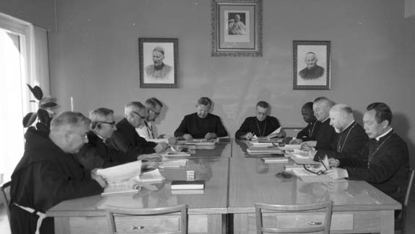
Introduction to Missiology
There is a relatively long history of mission documents in the Roman Catholic Church.
Of particular significance is the decree Ad Gentes (“On the Mission Activity of the Church”).
The first draft was rejected, the second (here is the drafting committee) was the last Council document to be approved, receiving a record number of positive votes (2,394,only 5 against)

Slide 3
Introduction to Missiology
Ad Gentes 2
The pilgrim Church is missionary by her very nature, since it is from the mission of the Son and the mission of the Holy Spirit that she draws her origin, in accordance with the decree of God the Father.
This decree, however, flows from the "fount - like love" or charity of God the Father who, being the "principle without principle" from whom the Son is begotten and Holy Spirit proceeds through the Son, freely creating us on account of His surpassing and merciful kindness and graciously calling us moreover to share with Him His life and His cry, has generously poured out, and does not cease to pour out still, His divine goodness.

Slide 4
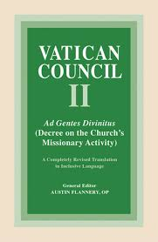
Introduction to Missiology
The mission of the Son and Holy Spirit
The call of the apostles and their successors to share in this mission
Since this mission goes on and in the course of history unfolds the mission of Christ Himself, who was sent to preach the Gospel to the poor, the Church, prompted by the Holy Spirit, must walk in the same path on which Christ walked: a path of poverty and obedience, of service and self - sacrifice to the death, from which death He came forth a victor by His resurrection. (Ad Gentes 5)

Slide 5

Introduction to Missiology
Thus, missionary activity among the nations differs from pastoral activity exercised among the faithful as well as from undertakings aimed at restoring unity among Christians. And yet these two ends are most closely connected with the missionary zeal because the division among Christians damages the most holy cause of preaching the Gospel to every creature and blocks the way to the faith for many. Hence, by the very necessity of mission, all the baptized are called to gather into one flock, and thus they will be able to bear unanimous witness before the nations to Christ their Lord. And if they are not yet capable of bearing witness to the same faith, they should at least be animated by mutual love and esteem.

Slide 6
Introduction to Missiology
Missionary activity is nothing else and nothing less than an epiphany, or a manifesting of God's decree, and its fulfilment in the world and in world history, in the course of which God, by means of mission, manifestly works out the history of salvation.
By the preaching of the word and by the celebration of the sacraments, the centre and summit of which is the most holy Eucharist, He brings about the presence of Christ, the author of salvation.
… whatever good is found to be sown in people’s hearts and minds, or in the rites and cultures peculiar to various peoples, not only is not lost, but is healed, uplifted, and perfected for the glory of God, the shame of the demon, and the bliss of humankind.
(Ad Gentes 9)

Slide 7
Introduction to Missiology
Mission work consists in
Christian Witness
Preaching the Gospel and Gathering together the People of God
Forming a Christian Community
This will lead to the establishment of new churches (dioceses with their own bishops)

Slide 8
Introduction to Missiology
Although every disciple of Christ, as far in him lies, has the duty of spreading the Faith, Christ the Lord always calls whomever He will from among the number of His disciples, to be with Him and to be sent by Him to preach to the nations (cf. Mark 3:13).
Therefore, by the Holy Spirit, who distributes the charismata as He wills for the common good (1 Cor. 12:11), He inspires the missionary vocation in the hearts of individuals, and at the same time He raises up in the Church certain institutes which take as their own special task the duty of preaching the Gospel, a duty belonging to the whole Church. (Ad Gentes 23)

Slide 9
Introduction to Missiology
The importance of a good contextual missionary training, preferably in the land where mission is to take place
Since the whole Church is missionary, and the work of evangelization is a basic duty of the People of God, this sacred synod invites all to a deep interior renewal; so that, having a vivid awareness of their own responsibility for spreading the Gospel, they may do their share in missionary work among the nations. (Ad Gentes 35)
The need for cooperation, between dioceses, with other churches, with the world

Slide 10
Introduction to Missiology
Since the promulgation of Ad Gentes in 1965, there have been a number of documents issued by the Roman Catholic Church. To mention just a few
1975 Evangelii Nuntiandi (Pope Paul VI), a very rich document, acknowledging the complexity of mission
1988 Christifideles Laici, looking at the task of lay people in the church (Pope John Paul II)
1990 Redemptoris Missio, on the 25th anniversary of Ad Gentes, calling the church to become more missionary (Pope John Paul II)
2013 Evangelii Gaudium, emphasising a theme that has run through his pontificate, the importance of being a missionary church (Pope Francis)

Slide 11
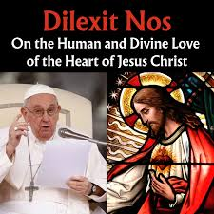
Introduction to Missiology
The most recent encyclical of Pope Francis, issued on 24 October 2024 is entitled Dilexit nos (He loved us).
Its main focus is the Sacred Heart of Jesus, but it contains frequent references to mission
Some examples:
The Gospel tells us that a rich man came up to Jesus, full of idealism yet lacking in the strength needed to change his life. Jesus then “looked at him” (Mk 10:21). Can you imagine that moment, that encounter between his eyes and those of Jesus? If Jesus calls you and summons you for a mission, he first looks at you, plumbs the depths of your heart and, knowing everything about you, fixes his gaze upon you. (Dilexit nos 39)

Slide 12
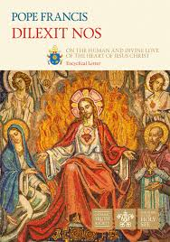
Introduction to Missiology
This then challenges us to seek a deeper understanding of the communitarian, social and missionary dimension of all authentic devotion to the heart of Christ. For even as Christ’s heart leads us to the Father, it sends us forth to our brothers and sisters. In the fruits of service, fraternity and mission that the heart of Christ inspires in our lives, the will of the Father is fulfilled. In this way, we come full circle: “My Father is glorified by this, that you bear much fruit” (Jn 15:8).
Dilexit nos 163

Slide 13
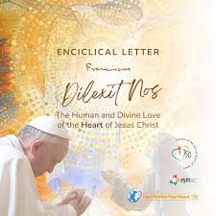
Introduction to Missiology
Mission, as a radiation of the love of the heart of Christ, requires missionaries who are themselves in love and who, enthralled by Christ, feel bound to share this love that has changed their lives. They are impatient when time is wasted discussing secondary questions or concentrating on truths and rules, because their greatest concern is to share what they have experienced. They want others to perceive the goodness and beauty of the Beloved through their efforts, however inadequate they may be.
Dilexit nos 209

Slide 14
Introduction to Missiology
Jesus is calling you and sending you forth to spread goodness in our world. His call is one of service, a summons to do good, perhaps as a physician, a mother, a teacher or a priest. Wherever you may be, you can hear his call and realize that he is sending you forth to carry out that mission.
He himself told us, “I am sending you out” (Lk 10:3). It is part of our being friends with him. For this friendship to mature, however, it is up to you to let him send you forth on a mission in this world, and to carry it out confidently, generously, freely and fearlessly. If you stay trapped in your own comfort zone, you will never really find security; doubts and fears, sorrow and anxiety will always loom on the horizon.
Dilexit nos 215

Slide 15
Introduction to Missiology
In 2013, at its tenth world conference in South Korea, the World Council of Churches adopted a new text on mission, Together towards Life: Mission and Evangelism in Changing Landscapes
The work of the WCC’s Commission on World Mission and Evangelism, which took on responsibility for mission at the WCC after its merger with the International Missionary Council in 1961.
The World Council of Churches, which to some extent is a child of the missionary movement, started in 1948 and has a membership of 352 churches, from over 120 countries, representing some 580 million Christians.
The first document on mission was in 1982: Mission and Evangelism: An Ecumenical Affirmation

Slide 16
Introduction to Missiology
After an affirmation of belief in a triune God, the document states (2)
Mission begins in the heart of the Triune God and the love which binds together the Holy Trinity overflows to all humanity and creation. The missionary God who sent the Son to the world calls all God’s people (John 20:21), and empowers them to be a community of hope. The church is commissioned to celebrate life, and to resist and transform all life-destroying forces, in the power of the Holy Spirit. How important it is to “receive the Holy Spirit” (John 20:22) to become living witnesses to the coming reign of God! From a renewed appreciation of the mission of the Spirit, how do we re-envision God’s mission in a changing and diverse world today?

Slide 17
Introduction to Missiology
Remembering the five marks of mission of the Anglican Communion, the document points also to the need to respect creation.
It also, as the frequent references to the Holy Spirit in the first paragraphs indicate, draws heavily on Pentecostal experiences.
Mission has been understood as a movement taking place from the centre to the periphery, and from the privileged to the marginalized of society. Now people at the margins are claiming their key role as agents of mission and affirming mission as transformation. This reversal of roles in the envisioning of mission has strong biblical foundations because God chose the poor, the foolish, and the powerless (1 Cor. 1:18-31) to further God’s mission of justice and peace so that life may flourish. If there is a shift of the mission concept from “mission to the margins” to “mission from the margins,” what then is the distinctive contribution of the people from the margins?
Together Towards Life 6

Slide 18
Introduction to Missiology
8. Evangelism is a confident but humble sharing of our faith and conviction with other people. Such sharing is a gift to others which announces the love, grace, and mercy of God in Christ. It is the inevitable fruit of genuine faith. Therefore, in each generation, the church must renew its commitment to evangelism as an essential part of the way we convey God’s love to the world. How can we proclaim God’s love and justice to a generation living in an individualized, secularized, and materialized world?
9. Locally and globally, Christians are engaged with people of other religions and cultures in building societies of love, peace, and justice. Plurality is a challenge to the churches and serious commitment to interfaith dialogue and cross-cultural communication is therefore indispensable. What are the ecumenical convictions regarding common witnessing and practicing life-giving mission in a world of many religions and cultures?

Slide 19
Introduction to Missiology
10. This statement highlights some key developments in understanding the mission of the Holy Spirit within the mission of the Triune God (missio Dei) which have emerged through the work of CWME. It does so under four main headings:
Spirit of Mission: Breath of Life
Spirit of Liberation: Mission from the Margins
Spirit of Community: Church on the Move
Spirit of Pentecost: Good News for All

Slide 20
Introduction to Missiology
The first section on Spirit of Mission: Breath of Life contains a reflection on the role of the Spirit in mission, the need for mission to include both action for and reflection on creation, the nature of spiritual gifts and the role of the Spirit in discernment, and the need for a transformative spirituality.
34. Mission provokes in us a renewed awareness that the Holy Spirit meets us and challenges us at all levels of life and brings newness and change to the places and times of our personal and collective journeys.
The emphasis on the Spirit is perhaps the key contribution of this document, since mission theology has tended to be principally Christological (this is the case, for example, with Ad Gentes and much of the other Roman Catholic writings on mission).

Slide 21
Introduction to Missiology
The second major subdivision looks at the “Spirit of Liberation: Mission from the Margins”.
The WCC has tended since the late 1960s to support a broadly “liberationist” approach, so it is not surprising to find this here.
37. … Mission from the margins calls for an understanding of the complexities of power dynamics, global systems and structures, and local contextual realities. Christian mission has at times been understood and practiced in ways which failed to recognize God’s alignment with those consistently pushed to the margins. Therefore, mission from the margins invites the church to re-imagine mission as a vocation from God’s Spirit who works for a world where the fullness of life is available for all.

Slide 22
Introduction to Missiology
40. Because the context of missional activity influences its scope and character, the social location of all engaged in mission work must be taken into account. Missiological reflections need to recognize the different value orientations that shape missional perspectives. The aim of mission is not simply to move people from the margins to centres of power but to confront those who remain the centre by keeping people on the margins. Instead, churches are called to transform power structures.
43. The affirmation of God’s mission (missio Dei) points to the belief in God as One who acts in history and in creation, in concrete realities of time and contexts, who seeks the fullness of life for the whole earth through justice, peace, and reconciliation. Participation in God’s ongoing work of liberation and reconciliation by the Holy Spirit, therefore, includes discerning and unmasking the demons that exploit and enslave. For example, this involves deconstructing patriarchal ideologies, upholding the right to self-determination for Indigenous peoples, and challenging the social embeddedness of racism and casteism.

Slide 23
Introduction to Missiology
Mission from the margins is a mission that also seeks justice and inclusivity and to bring healing and wholeness.
Integral mission (misión integral)
54. As a community of imperfect people, and as part of a creation groaning in pain and longing for its liberation, the Christian community can be a sign of hope and an expression of the kingdom of God here on earth (Rom. 8:22-24). The Holy Spirit works for justice and healing in many ways and is pleased to indwell the particular community which is called to embody Christ’s mission.

Slide 24
Introduction to Missiology
The next section looks at the “Spirit of Community: Church on the Move”, starting with “God’s Mission and the Life of the Church”
57. It is not possible to separate church and mission in terms of their origin or purpose. To fulfil God’s missionary purpose is the church’s aim.
The purpose of the church is also unity.
61. The lack of full and real unity in mission still harms the authenticity and credibility of the fulfilment of God’s mission in this world.
The document also realises that “God empowers the church in mission”
69. From a mission perspective, it is important to discern what helps the cause of God’s mission. In other words, unity in mission is the basis for the visible unity of the churches; this also has implications for the order of the church. Attempts to achieve unity must be in concert with the biblical call to seek justice. Our call to do justice may sometimes involve breaking false unities that silence and oppress. Genuine unity always entails inclusivity and respect for others.
The role of local congregations

Slide 25
Introduction to Missiology
Spirit of Pentecost: Good News for All
The call to evangelize – one of the ongoing tensions in mission is between “evangelism” (especially understood as verbal proclamation) and a more integral mission that includes but is not limited to verbal proclamation.
At the instigation especially of Orthodox churches, it is important to remember that
82 Today’s world is marked by excessive assertion of religious identities and persuasions that seem to break and brutalize in the name of God rather than heal and nurture communities. In such a context, it is important to recognize that proselytism is not a legitimate way of practicing evangelism.

Slide 26
Introduction to Missiology
83. Evangelism is sharing one’s faith and conviction with other people and inviting them to discipleship, whether or not they adhere to other religious traditions. Such sharing is to take place with both confidence and humility and as an expression of our professed love for our world. If we claim to love God and to love our fellow human beings but fail to share the good news with them urgently and consistently, we deceive ourselves as to the integrity of our love for either God or people. There is no greater gift we can offer to our fellow human beings than to share and or introduce them to the love, grace, and mercy of God in Christ.
85. … Different Christian traditions denote aspects of mission and evangelism in different ways; however, we can still affirm that the Spirit calls us all towards an understanding of evangelism which is grounded in the life of the local church where worship (leiturgia) is inextricably linked to witness (martyria), service (diakonia), and fellowship (koinonia).

Slide 27
Introduction to Missiology
The document acknowledges the failings of Christian missionaries, but repeats the need for dialogue, with all peoples, of all religious faiths or none, carried out in the spirit of Christ.
93. The Holy Spirit works in mysterious ways and we do not fully understand the workings of the Spirit in other faith traditions. We acknowledge that there is inherent value and wisdom in diverse life-giving spiritualities. Therefore, authentic mission makes the “other” a partner in, not an “object” of mission.
97. The gospel takes root in different contexts through engagement with specific cultural, political, and religious realities. Respect for people and their cultural and symbolic life-worlds are necessary if the gospel is to take root in those different realities. In this way it must begin with engagement and dialogue with the wider context in order to discern how Christ is already present and where God’s Spirit is already at work.

Slide 28
Introduction to Missiology
The document ends with a series of affirmations:
102. We affirm that the purpose of God’s mission is fullness of life (John 10:10) and that this is the criterion for discernment in mission.
103. We affirm that mission begins with God’s act of creation and continues in re-creation, by the enlivening power of the Holy Spirit.
104. We affirm that spirituality is the source of energy for mission and that mission in the Spirit is transformative.
105. We affirm that the mission of God’s Spirit is to renew the whole creation.
106. We affirm that today mission movements are emerging from the global South and East which are multi-directional and many-faceted.

Slide 29
Introduction to Missiology
107. We affirm that marginalized people are agents of mission and exercise a prophetic role which emphasizes that fullness of life is for all.
108. We affirm that the economy of God is based on values of love and justice for all and that transformative mission resists idolatry in the free-market economy.
109. We affirm that the gospel of Jesus Christ is good news in all ages and places and should be proclaimed in the Spirit of love and humility.
110. We affirm that dialogue and cooperation for life are integral to mission and evangelism.
111. We affirm that God moves and empowers the church in mission.

Slide 30
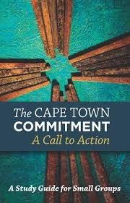
Introduction to Missiology
The Cape Town Commitment
Cape Town 2010: The Third Lausanne Congress on World Evangelization
The first was in Lausanne in 1974, the second in Manila in 1989. The fourth took place in Seoul earlier this year.
Since Manila, they have issued alliterative documents: the Manila Manifesto, the Cape Town Commitment and now the Seoul Statement.
The Lausanne Committee for World Evangelisation was formed through the inspiration of Billy Graham, among others, to promote an evangelical mission approach, though it also argued for a holistic mission.

Slide 31
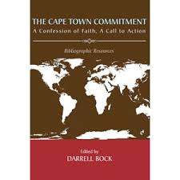
Introduction to Missiology
The Commitment is a fairly long document (over 100 pages), so this is a very brief summary.
The document begins with a confession of faith, the first part, based on an affirmation of God’s love for us and our love for God:
1. WE LOVE BECAUSE GOD FIRST LOVED US
The mission of God flows from the love of God. The mission of God’s people flows from our love for God and for all that God loves. World evangelization is the outflow of God’s love to us and through us. We affirm the primacy of God’s grace and we then respond to that grace by faith, demonstrated through the obedience of love. We love because God first loved us and sent his Son to be the propitiation for our sins.

Slide 32

Introduction to Missiology
The first part acknowledges love for the living God, Father, Son, and Spirit, and for God’s word, God’s world, the gospel of God, the people of God and the mission of God
There is no true or whole gospel, and no authentic biblical mission, without the Person, work and power of the Holy Spirit. We pray for a greater awakening to this biblical truth, and for its experience to be reality in all parts of the worldwide body of Christ. However, we are aware of the many abuses that masquerade under the name of the Holy Spirit, the many ways in which all kinds of phenomena are practised and praised which are not the gifts of the Holy Spirit as clearly taught in the New Testament

Slide 33
Introduction to Missiology
The second part focuses on the call to action
A. Bearing witness to the truth of Christ in a pluralistic, globalized world.
B. Building the peace of Christ in our divided and broken world.
C. Living the love of Christ among people of other faiths.
“In the name of the God of love, we repent of our failure to seek friendships with people of Muslim, Hindu, Buddhist and other religious backgrounds. In the spirit of Jesus, we will take initiatives to show love, goodwill and hospitality to them.”

Slide 34
Introduction to Missiology
D. Discerning the will of Christ for world evangelization.
Six key areas: (a) unreached and unengaged people groups; (b) oral cultures; (c) Christ-centred leaders; (d) cities; (e) children and (f) prayer.
“Prayer is the indispensable foundation and resource for all elements of our mission.”
E. Calling the Church of Christ back to humility, integrity and simplicity.
This contains a mix of calls for a church that rejects what “idolatries”, of disordered sexuality, of power, of success, and of greed
F. Partnering in the body of Christ for unity in mission.
“The mission of the Church on earth is to serve the mission of God, and the mission of theological education is to strengthen and accompany the mission of the Church”

Slide 35
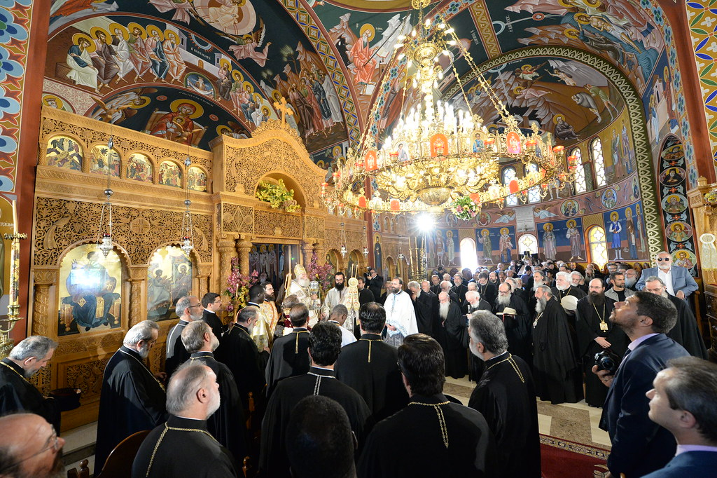
Introduction to Missiology
The Holy and Great Council of the Orthodox Church, held in Crete in June 2016
THE MISSION OF THE ORTHODOX CHURCH IN TODAY’S WORLD
The contribution of the Orthodox Church in realizing
peace, justice, freedom, fraternity and love between peoples, and in
the removal of racial and other discriminations.

Slide 36
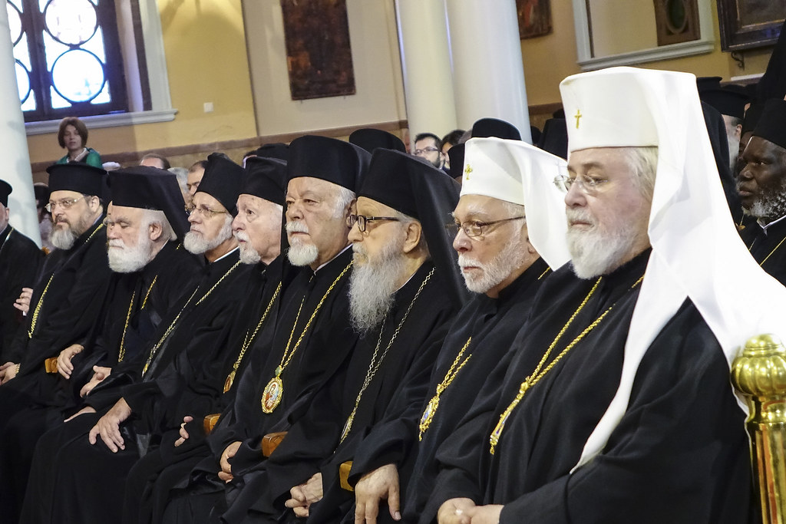
Introduction to Missiology
“The Church as the Body of the incarnate Logos of God (John Chrysostom, Homily before Exile, 2 PG 52, 429) constitutes the living “presence” as the sign and image of the Kingdom of the Triune God in history, proclaims the good news of a new creation (II Cor 5:17), of new heavens and a new earth in which righteousness dwells (II Pt 3:13); news of a world in which God will wipe away every tear from people’s eyes; there shall be no more death, nor sorrow, nor crying. There shall be no more pain (Rev 21:4-5).”

Slide 37
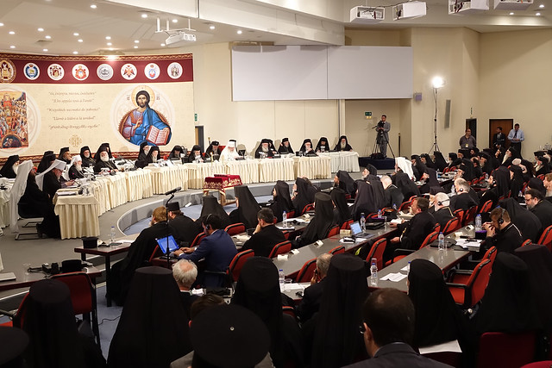
Introduction to Missiology
“mission must be carried out not aggressively or by different forms of proselytism, but in love, humility and respect towards the identity of each person and the cultural particularity of each people. All the Orthodox Church have an obligation to contribute to this missionary endeavour.”
The council affirms the dignity of each human person, freedom and responsibility, and the need for peace and justice.

Slide 38
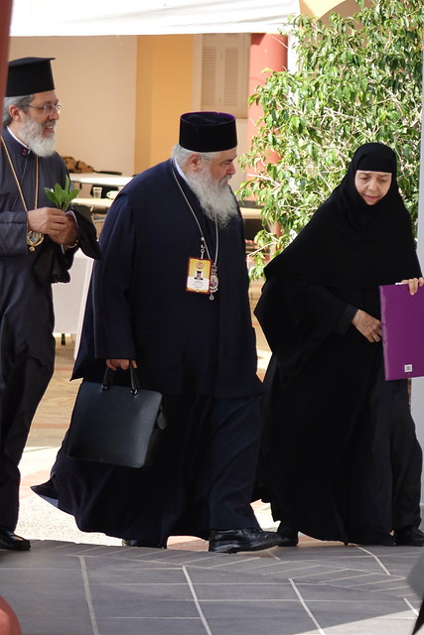
Introduction to Missiology
It also speaks for peace and against war (the Russian Orthodox Church and some of its allies withdrew from the Council shortly before it was due to take place).
The document affirms equality, speaking out against discrimination:
“The Orthodox Church confesses that every human being, regardless of skin colour, religion, race, sex, ethnicity, and language, is created in the image and likeness of God, and enjoys equal rights in society. Consistent with this belief, the Orthodox Church rejects discrimination for any of the aforementioned reasons since these presuppose a difference in dignity between people.”

Slide 39
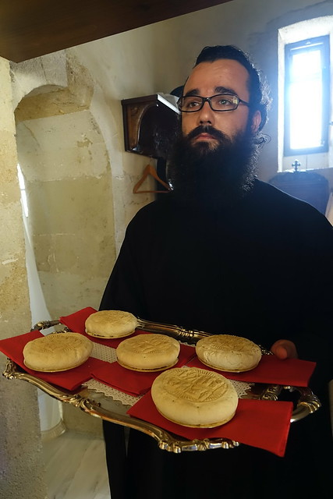
Introduction to Missiology
The task of service
“In fulfilling her salvific mission in the world, the Orthodox Church actively cares for all people in need, including the hungry, the poor, the sick, the disabled, the elderly, the persecuted, those in captivity and prison, the homeless, the orphans, the victims of destruction and military conflict, those affected by human trafficking and modern forms of slavery. The Orthodox Church’s efforts to confront destitution and social injustice are an expression of her faith and the service to the Lord, Who identifies Himself with every person and especially with those in need: Inasmuch as you did it to one of the least of these my brethren, you did it to me (Mt 25:40). This multidimensional social service enables the Church to cooperate with various relevant social institutions.”

Slide 40
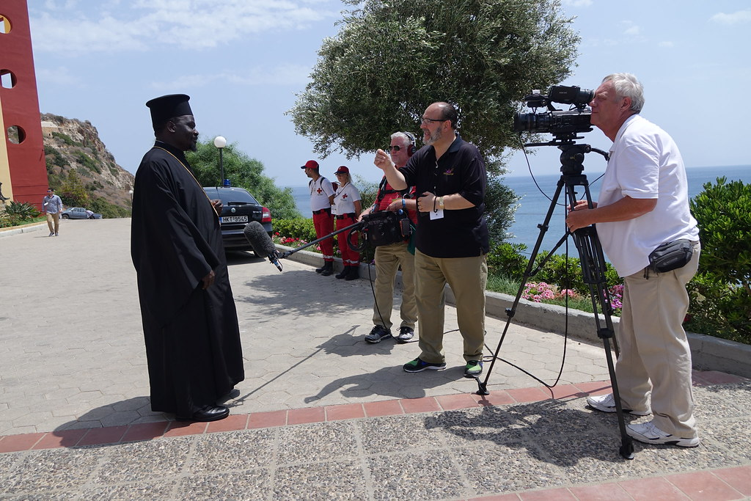
Introduction to Missiology
“The yearning for continuous growth in prosperity and an unfettered consumerism inevitably lead to a disproportionate use and depletion of natural resources.”
“The ecological crisis, which is connected to climate change and global warming, makes it incumbent upon the Church to do everything within her spiritual power to protect God’s creation from the consequences of human greed. As the gratification of material needs, greed leads to spiritual impoverishment of the human being and to environmental destruction. We should not forget that the earth’s natural resources are not our property, but the Creator’s: The earth is the Lord’s, and all its fullness, the world, and those who dwell therein (Ps 23:1). Therefore, the Orthodox Church emphasizes the protection of God’s creation through the cultivation of human responsibility for our God-given environment and the promotion of the virtues of frugality and self-restraint.”

